Slide 1
FeFFFegatolllllllllll
Co.Vi.D.19 e Fegato
Antonio Digiacomo
Direttore Dipartimento Area Medica
ASP Ragusa
Grecas Palermo, 3/12/2022

Slide 2
Notes:
Procoagulant factors and IL-6 are significantly increased in COVID-19 patients with liver injury.
(A) Serum levels of fibrinogen (n = 57), factor VIII activity (n = 65), and factor II activity (n = 65) in patients with liver injury in an initial sample of patients with COVID-19 (n = 68). (B,C) Retrospective analysis using a large database of COVID-19 inpatients from 3/10/2020 to 12/1/2020 (n = 3,780). (B) Serum levels of fibrinogen (n = 3,344), D-dimer (n = 3,478), vWF activity (n = 129), vWF Ag (n = 131), and hsCRP (n = 2,828) in patients with COVID-19. (C) Initial IL-6 levels in patients with COVID-19. ALT <3x (n = 1,110) and ≥3x (n = 481). (D) Correlation between serum IL-6 and vWF antigen (n = 119), factor VIII activity (n = 126), and D-dimer (n = 1,600). Means compared with 2-tailed Student’s t test for (A) and medians compared with 2-tailed Mann-Whitney U test for (B), (C). Correlation in (D) assessed with Pearson correlation. Patients excluded in each analysis if necessary data not available. ALT, alanine aminotransferase; hsCRP, high-sensitivity C-reactive protein; IL-6, interleukin-6; vWF, von Willebrand factor; vWF Ag, VWF antigen.

Slide 3
Liver injury in COVID-19 and IL-6 trans-signaling-induced endotheliopathy
Matthew J. McConnell, Nao Kawaguchi, Reiichiro Kondo, Aurelio Sonzogni, Lisa Licini, Clarissa Valle, Pietro A. Bonaffini, Sandro Sironi, Maria Grazia Alessio, Giulia Previtali, Michela Seghezzi, Xuchen Zhang, Alfred I. Lee, Alexander B. Pine, Hyung J. Chun, Xinbo Zhang, Carlos Fernandez-Hernando, Hua Qing, Andrew Wang, Christina Price, Zhaoli Sun, Teruo Utsumi, John Hwa, Mario Strazzabosco, Yasuko Iwakiri
Journal of Hepatology
Volume 75 Issue 3 Pages 647-658 (September 2021)
DOI: 10.1016/j.jhep.2021.04.050
Copyright © 2021 European Association for the Study of the Liver Terms and Conditions

Slide 4
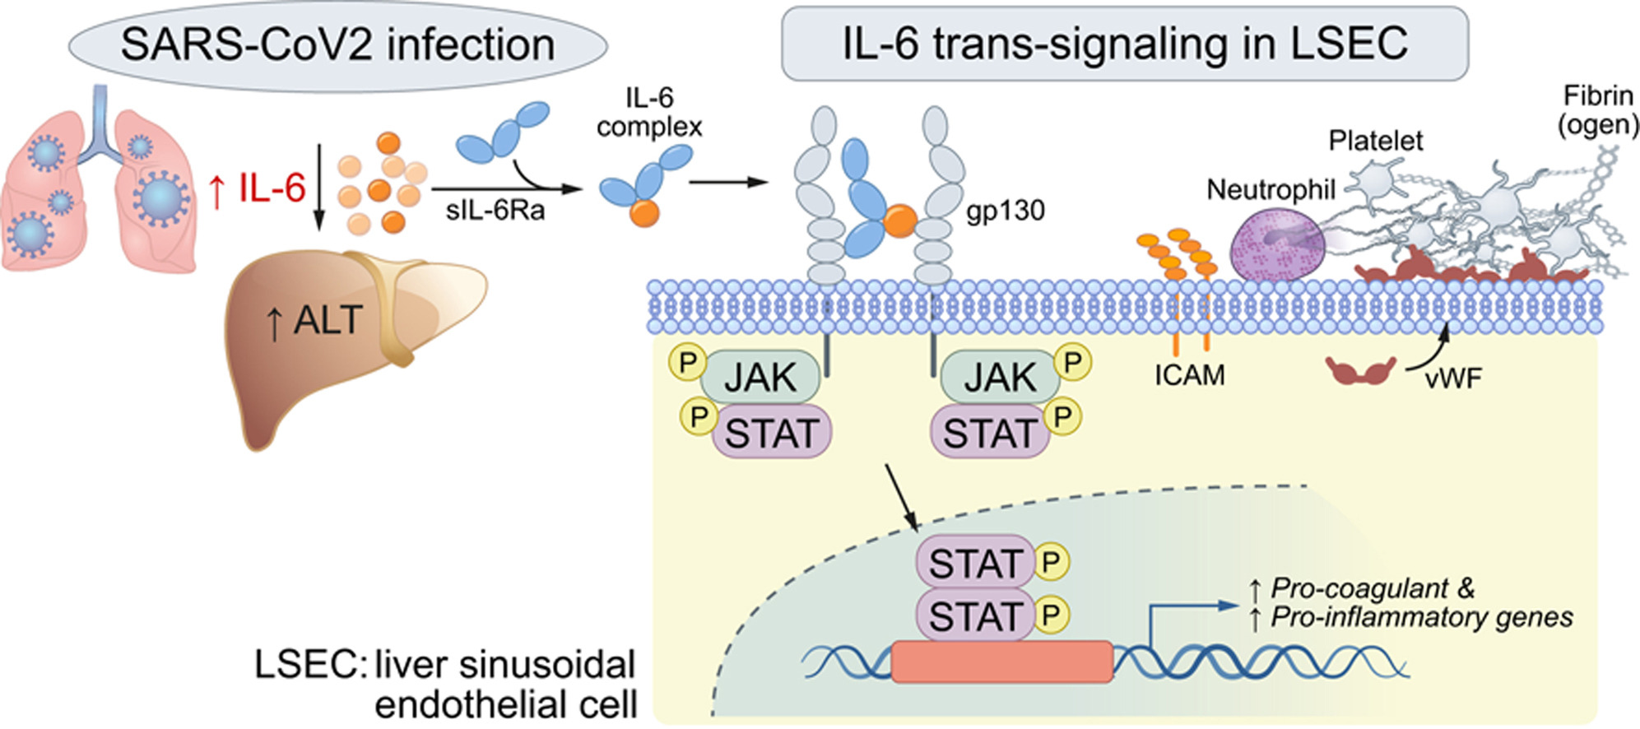
Journal of Hepatology 2021 75647-658DOI: (10.1016/j.jhep.2021.04.050)
Copyright © 2021 European Association for the Study of the Liver Terms and Conditions

Slide 5
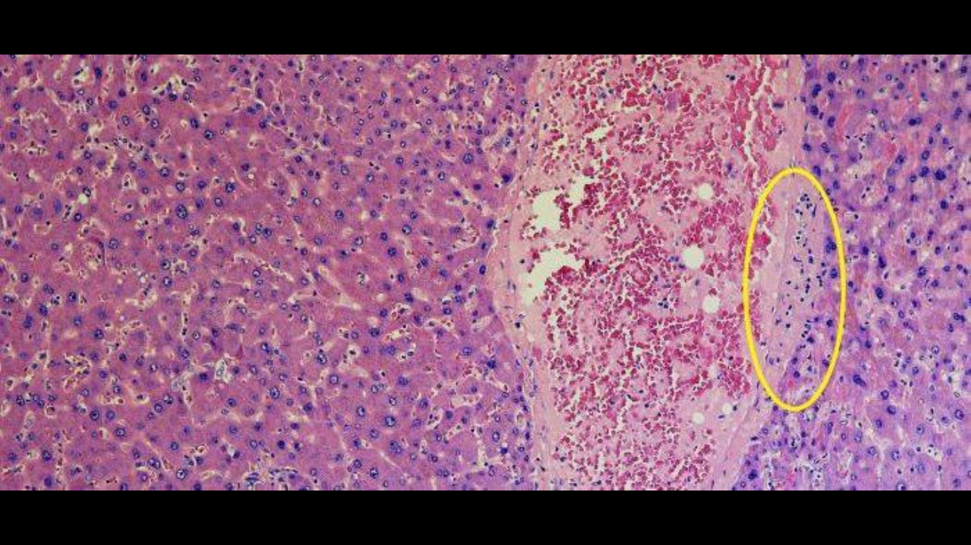
Notes:
Procoagulant factors and IL-6 are significantly increased in COVID-19 patients with liver injury.
(A) Serum levels of fibrinogen (n = 57), factor VIII activity (n = 65), and factor II activity (n = 65) in patients with liver injury in an initial sample of patients with COVID-19 (n = 68). (B,C) Retrospective analysis using a large database of COVID-19 inpatients from 3/10/2020 to 12/1/2020 (n = 3,780). (B) Serum levels of fibrinogen (n = 3,344), D-dimer (n = 3,478), vWF activity (n = 129), vWF Ag (n = 131), and hsCRP (n = 2,828) in patients with COVID-19. (C) Initial IL-6 levels in patients with COVID-19. ALT <3x (n = 1,110) and ≥3x (n = 481). (D) Correlation between serum IL-6 and vWF antigen (n = 119), factor VIII activity (n = 126), and D-dimer (n = 1,600). Means compared with 2-tailed Student’s t test for (A) and medians compared with 2-tailed Mann-Whitney U test for (B), (C). Correlation in (D) assessed with Pearson correlation. Patients excluded in each analysis if necessary data not available. ALT, alanine aminotransferase; hsCRP, high-sensitivity C-reactive protein; IL-6, interleukin-6; vWF, von Willebrand factor; vWF Ag, VWF antigen.

Slide 6
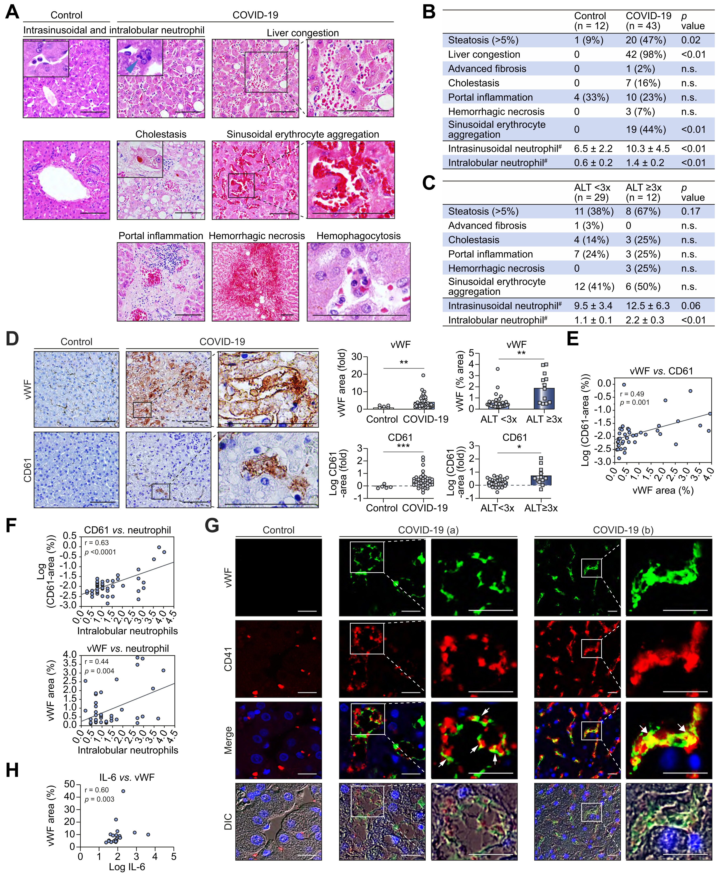
Fig. 2
Journal of Hepatology 2021 75647-658DOI: (10.1016/j.jhep.2021.04.050)
Copyright © 2021 European Association for the Study of the Liver Terms and Conditions
Notes:
Expression of vWF in the liver is associated with increased platelet adhesion and liver injury in COVID-19.
(A) Representative liver histological features in patients with COVID-19 and controls. Scale bars:100 μm. (B) Summary of histological features (H&E staining) of the livers from patients with COVID-19 (n = 43) and controls (n = 12). #: Neutrophils per high-power field (C) Summary of histological features associated with liver injury: ALT <3x (n = 29) and ≥3x (n = 12). (D) Immunohistochemistry for vWF and CD61 in the liver from patients with COVID-19 and controls. Scale bars:100 μm. Comparisons of vWF and CD61 positive areas in the liver from patients with COVID-19 (n = 43) and controls (n = 5) (Upper and lower left graphs), as well as those from patients with liver injury (n = 12) and those without (n = 29) (upper and lower right graphs). (E) Correlation between vWF and CD61 positive areas in the livers of patients with COVID-19 (n = 43). (F) Correlation between intralobular neutrophils and CD61-positive area (n = 43) and vWF-positive area (n = 43) in the livers of patients with COVID-19. (G) Immunofluorescence of vWF and CD41 (a platelet marker) in the livers from patients with COVID-19 and controls. Scale bars: 25 μm. In patients with COVID-19, vWF is expressed mainly on LSECs, and CD41-positive platelets attach to these LSECs (arrow head). A lower level of vWF is expressed on CD41-positive platelets (arrow). (a) and (b) are different fields from the same patient. (H) Correlation between IL-6 and vWF-positive area in COVID-19 patients. Comparisons between 2 groups were obtained using Welch’s t test for continuous variables, Chi-squared test was used for categorical variables. Pearson’s correlation co-efficients were calculated to examine the correlation among vWF area, CD61 area, and intralobular neutrophils. Spearman correlation was used to examine the correlation between serum IL-6 level and vWF area. Biochemical liver injury in 2 patients with COVID-19 could not be classified (no available ALT value). Data are mean ± SEM. ∗p <0.05, ∗∗p <0.01, ∗∗∗p <0.001. ALT, alanine aminotransferase; DIC, differential interference contrast; IL-6, interleukin-6; LSECs, liver sinusoidal endothelial cells; vWF, von Willebrand factor.

Slide 7
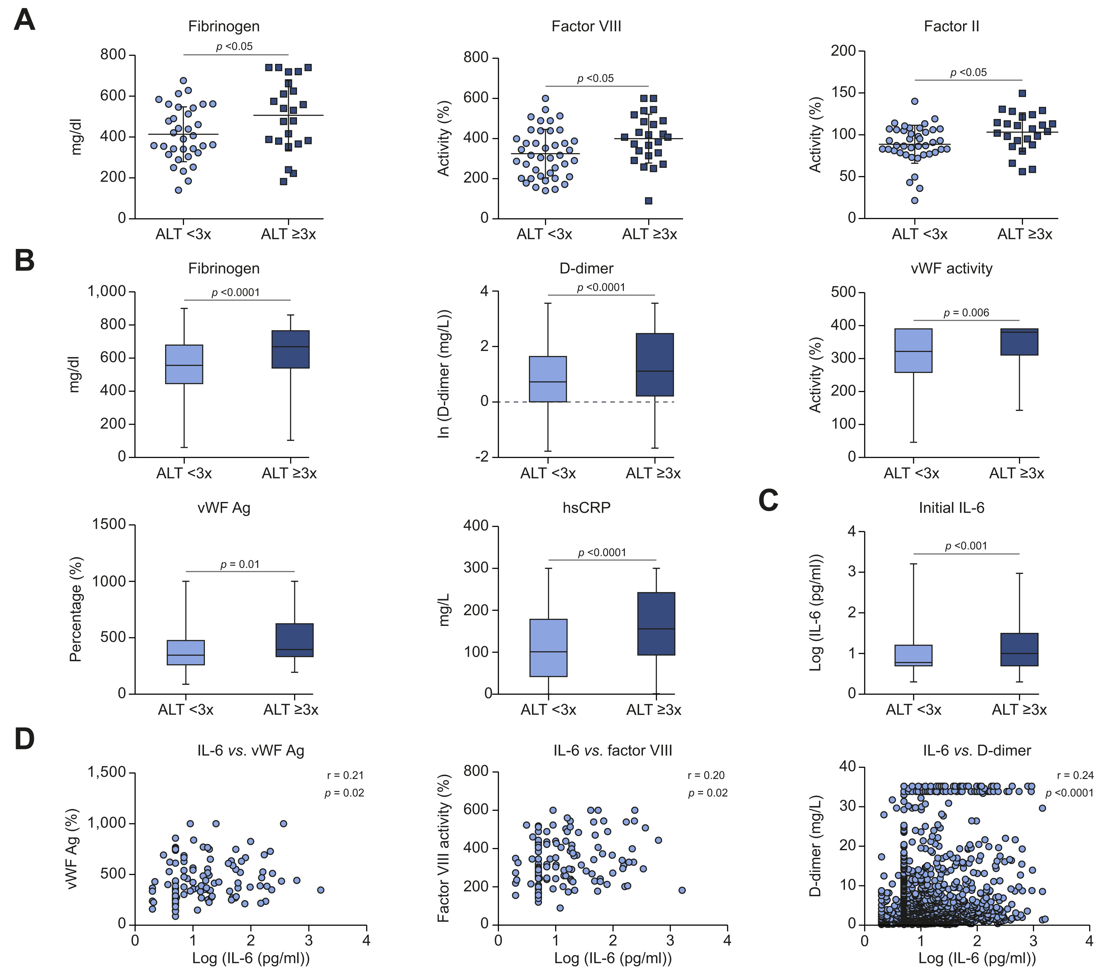
Fig. 1
Journal of Hepatology 2021 75647-658DOI: (10.1016/j.jhep.2021.04.050)
Copyright © 2021 European Association for the Study of the Liver Terms and Conditions
Notes:
Procoagulant factors and IL-6 are significantly increased in COVID-19 patients with liver injury.
(A) Serum levels of fibrinogen (n = 57), factor VIII activity (n = 65), and factor II activity (n = 65) in patients with liver injury in an initial sample of patients with COVID-19 (n = 68). (B,C) Retrospective analysis using a large database of COVID-19 inpatients from 3/10/2020 to 12/1/2020 (n = 3,780). (B) Serum levels of fibrinogen (n = 3,344), D-dimer (n = 3,478), vWF activity (n = 129), vWF Ag (n = 131), and hsCRP (n = 2,828) in patients with COVID-19. (C) Initial IL-6 levels in patients with COVID-19. ALT <3x (n = 1,110) and ≥3x (n = 481). (D) Correlation between serum IL-6 and vWF antigen (n = 119), factor VIII activity (n = 126), and D-dimer (n = 1,600). Means compared with 2-tailed Student’s t test for (A) and medians compared with 2-tailed Mann-Whitney U test for (B), (C). Correlation in (D) assessed with Pearson correlation. Patients excluded in each analysis if necessary data not available. ALT, alanine aminotransferase; hsCRP, high-sensitivity C-reactive protein; IL-6, interleukin-6; vWF, von Willebrand factor; vWF Ag, VWF antigen.

Slide 8
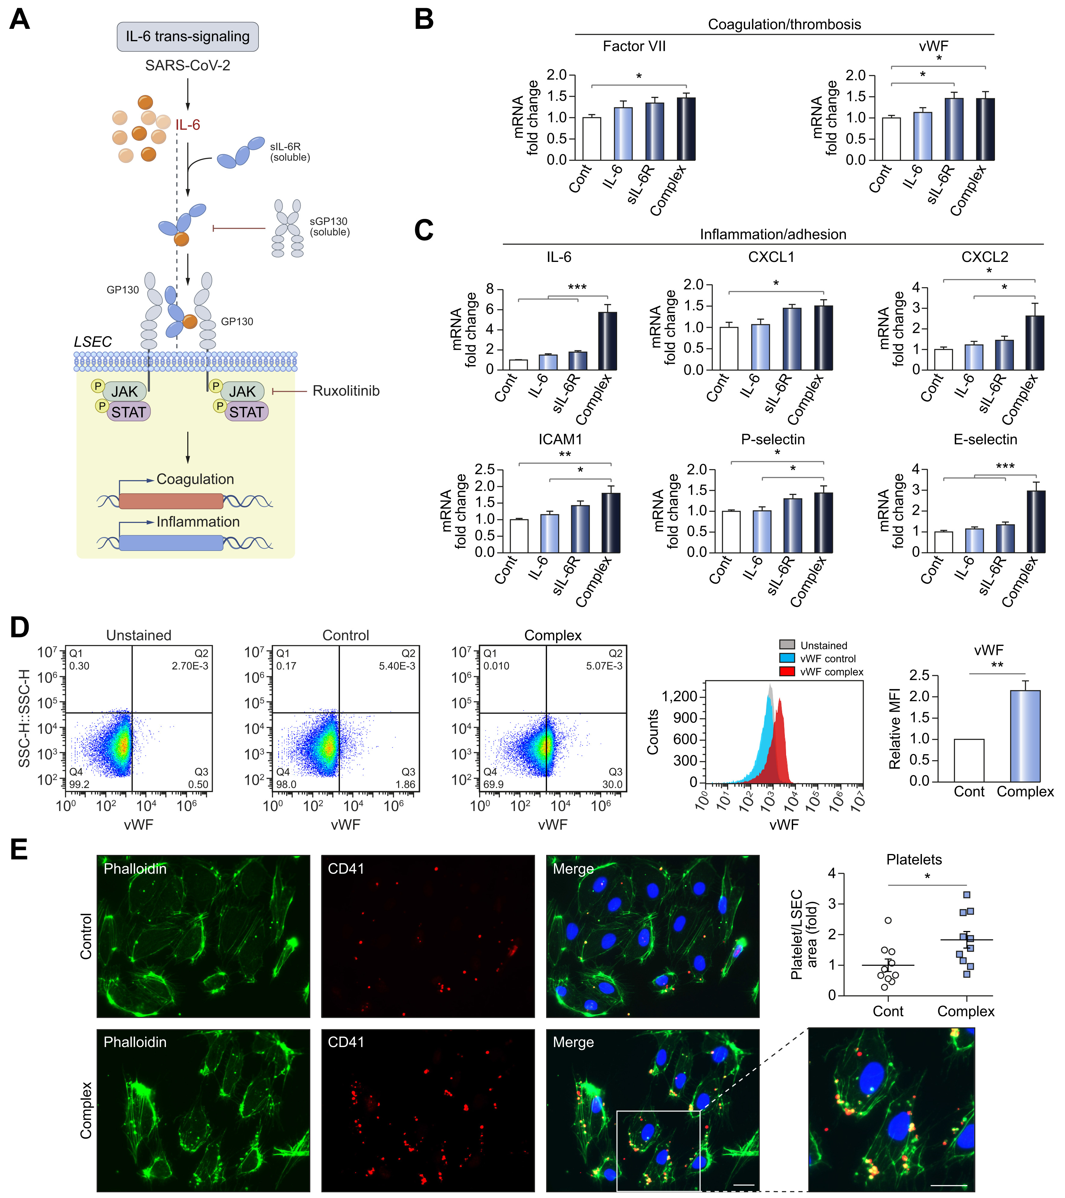
Fig. 3
Journal of Hepatology 2021 75647-658DOI: (10.1016/j.jhep.2021.04.050)
Copyright © 2021 European Association for the Study of the Liver Terms and Conditions
Notes:
IL-6 trans-signaling induces endotheliopathy and increases cell surface levels of vWF and platelet attachment to LSECs.
(A) Schema of IL-6 trans-signaling and blocking by soluble gp130 or ruxolitinib. (B,C) qPCR of markers for (B) procoagulant and (C) proinflammatory endotheliopathy. Human primary LSECs were incubated with control, human recombinant IL-6 (20 ng/ml), human recombinant sIL-6R (20 ng/ml) or IL-6/sIL-6R complex (20 ng/ml) for 1 hour. Graphs show the fold-change (control is set to 1). n
= 6. (D) Flow cytometry for cell surface levels of vWF in LSECs treated with control or IL-6/sIL-6R complex (20 ng/ml) for 6 hours. n = 3. (E) Platelet attachment to LSECs. Phalloidin (Green, F-actin for cell structure), CD41 (Red, platelet). LSECs were treated with control or IL-6/sIL-6R complex (20 ng/ml) for 4 hours and incubated with platelets for 2 hours. Scale bar = 10 μm n = 10. Data are mean ± SEM of at least 3 experiments. One-way ANOVA with Tukey’s test for multiple groups, or 2-tailed unpaired t test for 2 groups was used. ∗p <0.05, ∗∗p <0.01, ∗∗∗p <0.001. CXCL, chemokine (C-X-C motif) ligand; ICAM1, intercellular adhesion molecule 1; IL-6, interleukin-6; LSECs, liver sinusoidal endothelial cells; qPCR, quantitative PCR; sIL-6R, soluble IL-6 receptor; vWF, von Willebrand factor.

Slide 9
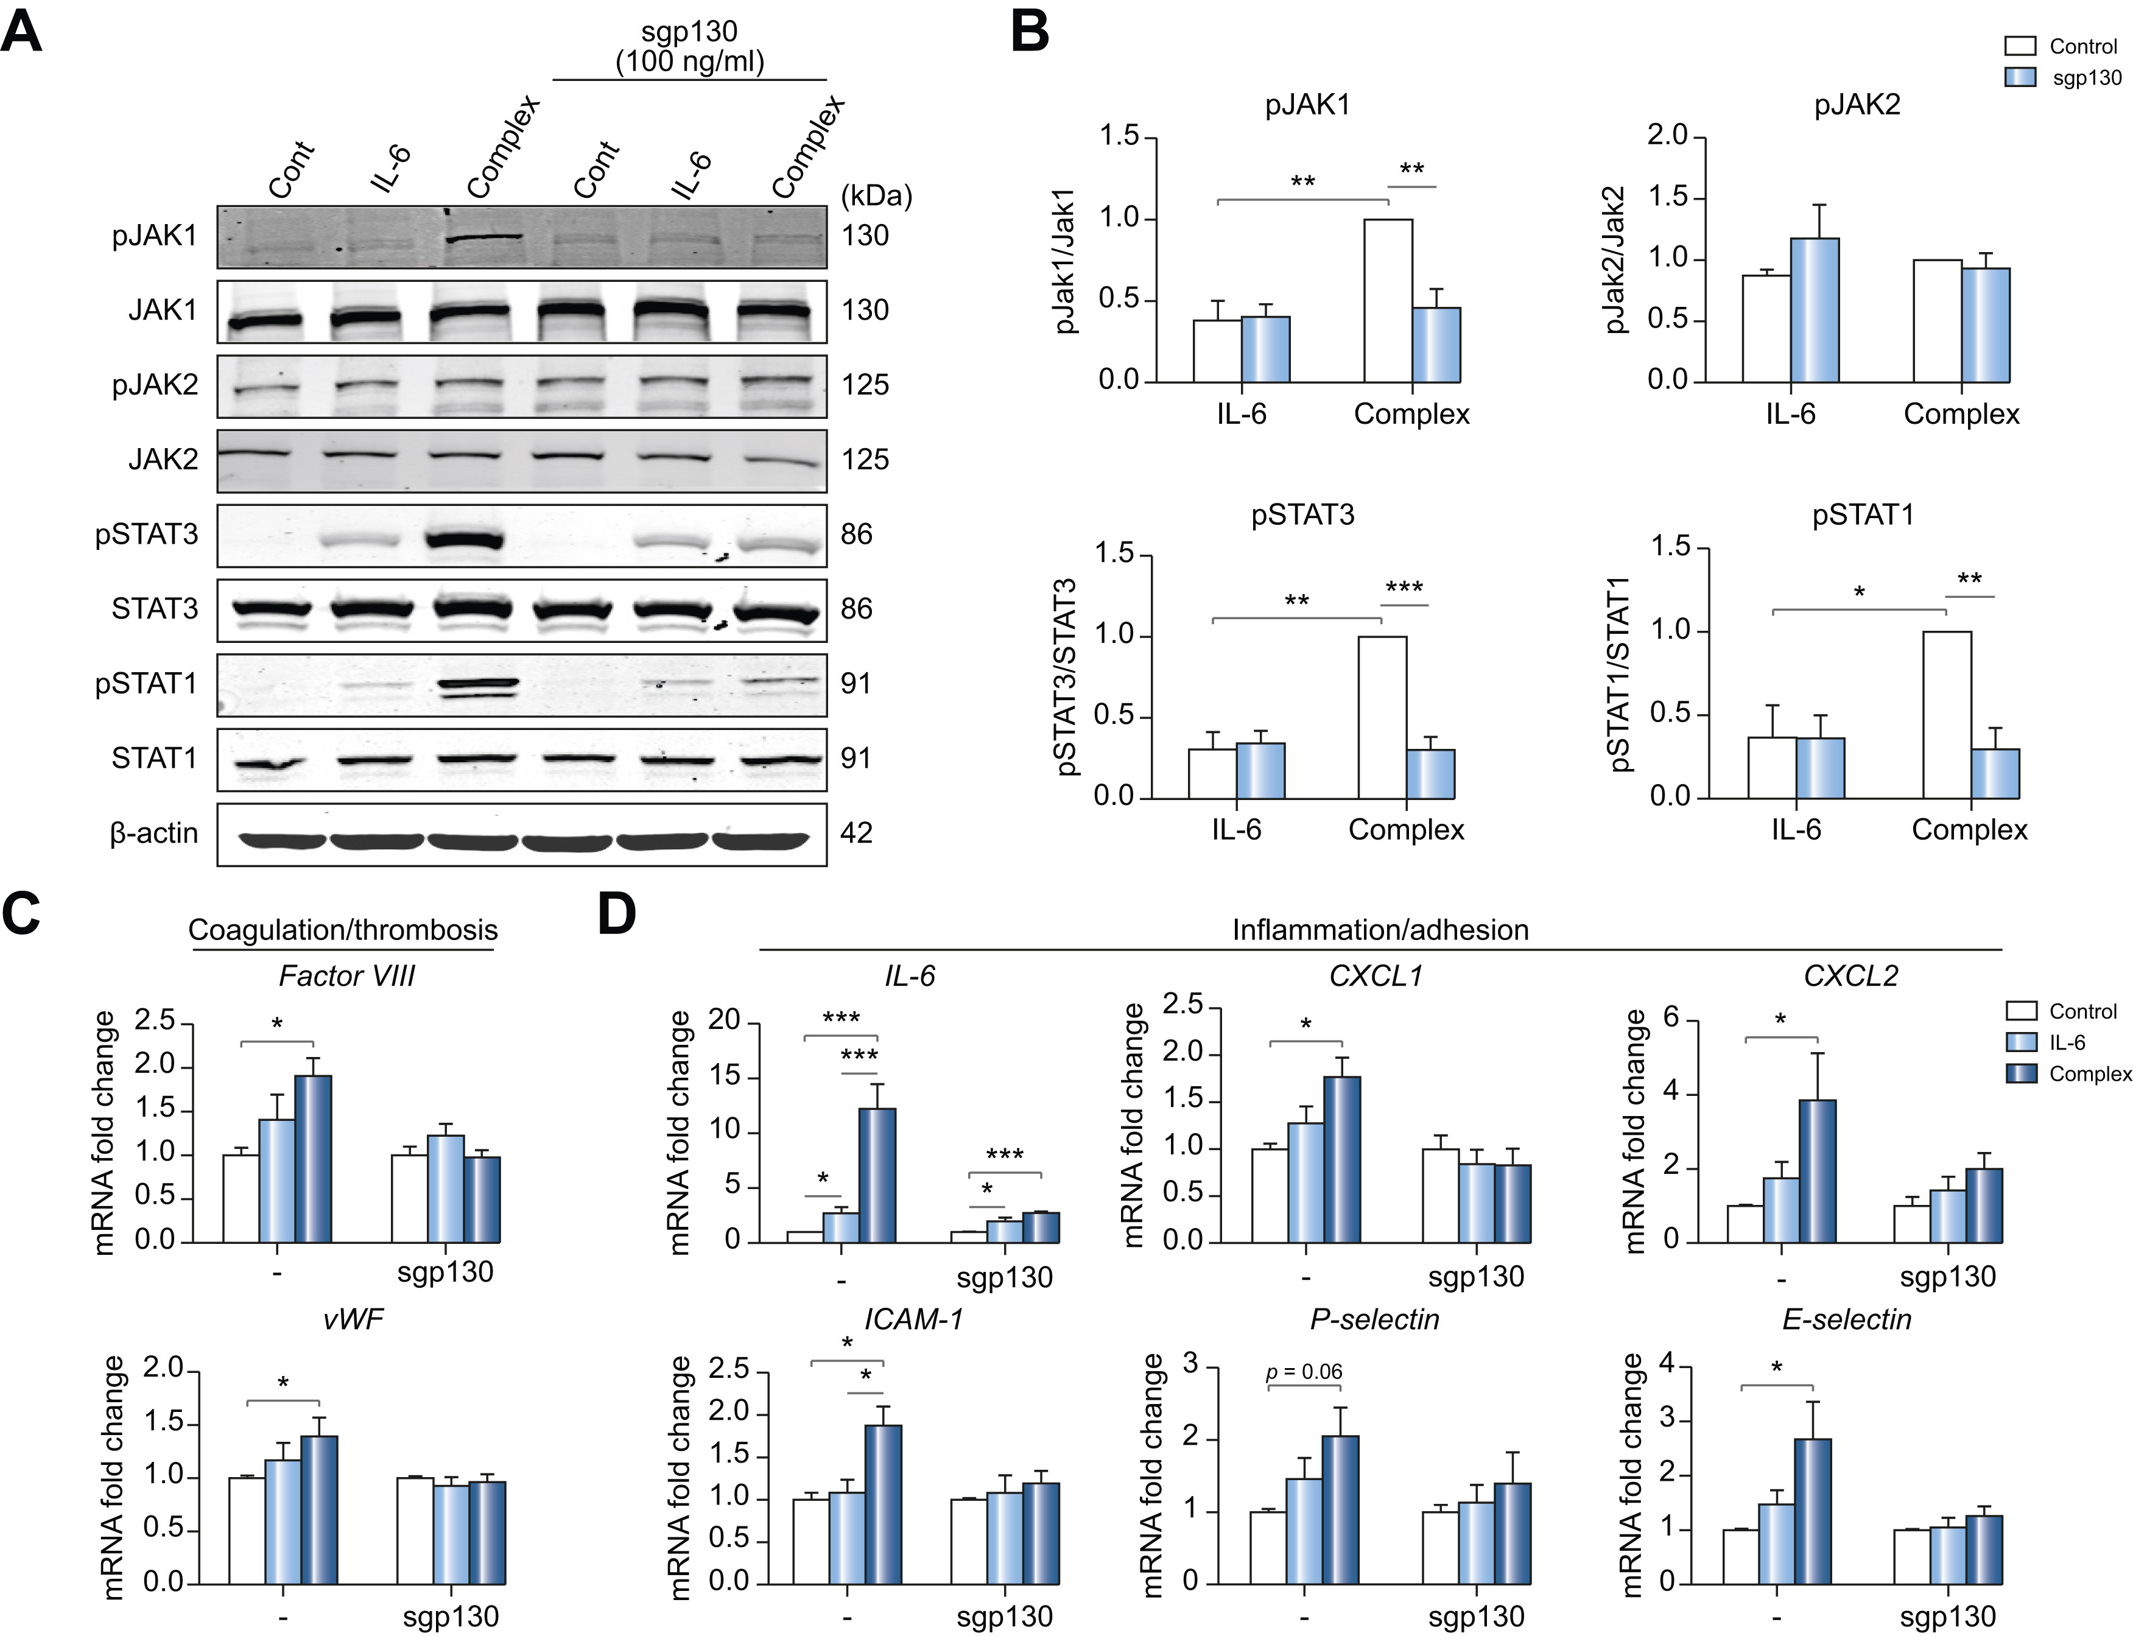
Fig. 4
Journal of Hepatology 2021 75647-658DOI: (10.1016/j.jhep.2021.04.050)
Copyright © 2021 European Association for the Study of the Liver Terms and Conditions
Notes:
Soluble gp130 blocks JAK1 and STAT3 phosphorylation induced by IL-6 trans-signaling in LSECs.
Human primary LSECs were treated with control, IL-6 (20 ng/ml) or IL-6/sIL-6R complex (20 ng/ml) in the presence or absence of sgp130 Fc (100 ng/ml) for 15 minutes (western blot) and 1 hour (qPCR). (A) A representative blot. β-actin (loading control). n = 3. (B) Activation (phosphorylation) of JAK1, JAK2, STAT3 and STAT1. The fold-change for quantification of western blot. (complex without sgp130 is set to 1). n = 3. qPCR of markers for (C) procoagulant and (D) proinflammatory endotheliopathy in LSECs with or without sgp130 Fc (100 ng/ml). n = 6. Control is set to 1 for each experiment and data presented as fold-change vs. complex. Data are mean ± SEM of at least 3 experiments. One-way ANOVA with Tukey’s test for multiple groups, or 2-tailed unpaired t test for 2 groups was used. ∗p <0.05, ∗∗p <0.01, ∗∗∗p <0.001. CXCL, chemokine (C-X-C motif) ligand; gp130, glycoprotein 130; ICAM1, intercellular adhesion molecule 1; IL-6, interleukin-6; JAK, Janus kinase; LSECs, liver sinusoidal endothelial cells; qPCR, quantitative PCR; sgp130, soluble gp130; sIL-6R, soluble IL-6 receptor; STAT, signal transducer and activator of transcription.

Slide 10
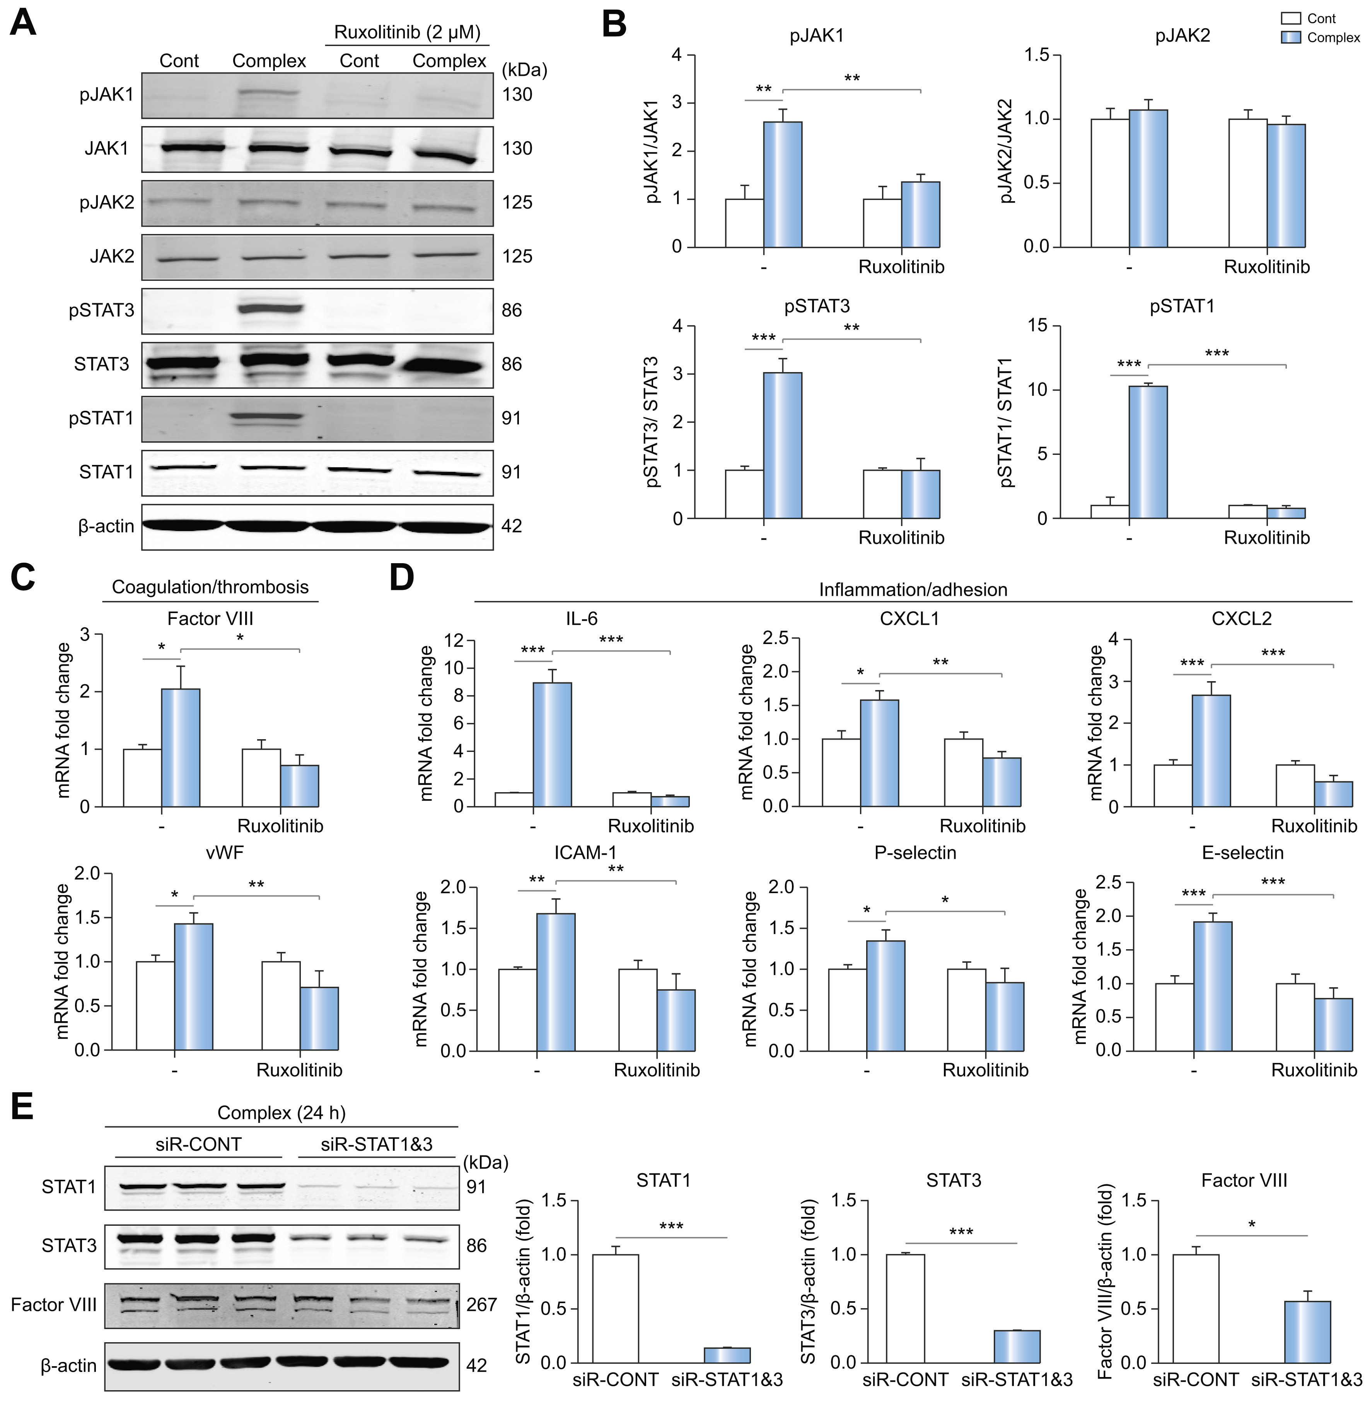
Fig. 5
Journal of Hepatology 2021 75647-658DOI: (10.1016/j.jhep.2021.04.050)
Copyright © 2021 European Association for the Study of the Liver Terms and Conditions
Notes:
JAK inhibitor ruxolitinib blocks JAK1/STAT3 induction by IL-6 trans-signaling and blocks procoagulant endotheliopathy in LSECs.
Human primary LSECs were treated with control or IL-6/sIL-6R complex (20 ng/ml) in the presence or absence of ruxolitinib (2 μM) for 15 minutes (western blot) and 1 hour (qPCR). Cells were incubated with ruxolitinib for 20 minutes before treatment with complex. (A) Representative western blot. (B) Quantification of western blot. Control is set to 1 for each experiment and data presented as fold-change vs. complex. n = 3. qPCR of markers for (C) procoagulant and (D) proinflammatory endotheliopathy in LSECs with or without ruxolitinib. The graphs show the fold-change (control is set to 1). n = 6. (E) Representative western blot and its quantification. LSECs were treated with siRNA-STAT1 & 3 [STAT1 (10 nM), STAT3 (20 nM) for 64 hours] and then incubated with control or IL-6/sIL-6R complex for 24 hours. n = 3. Data are mean ± SEM of at least 3 experiments. Two-tailed unpaired t test was used. ∗p <0.05, ∗∗p <0.01, ∗∗∗p <0.001. IL-6, interleukin-6; JAK, Janus kinase; LSECs, liver sinusoidal endothelial cells; qPCR, quantitative PCR; sIL-6R, soluble IL-6 receptor; STAT, signal transducer and activator of transcription.

Slide 11
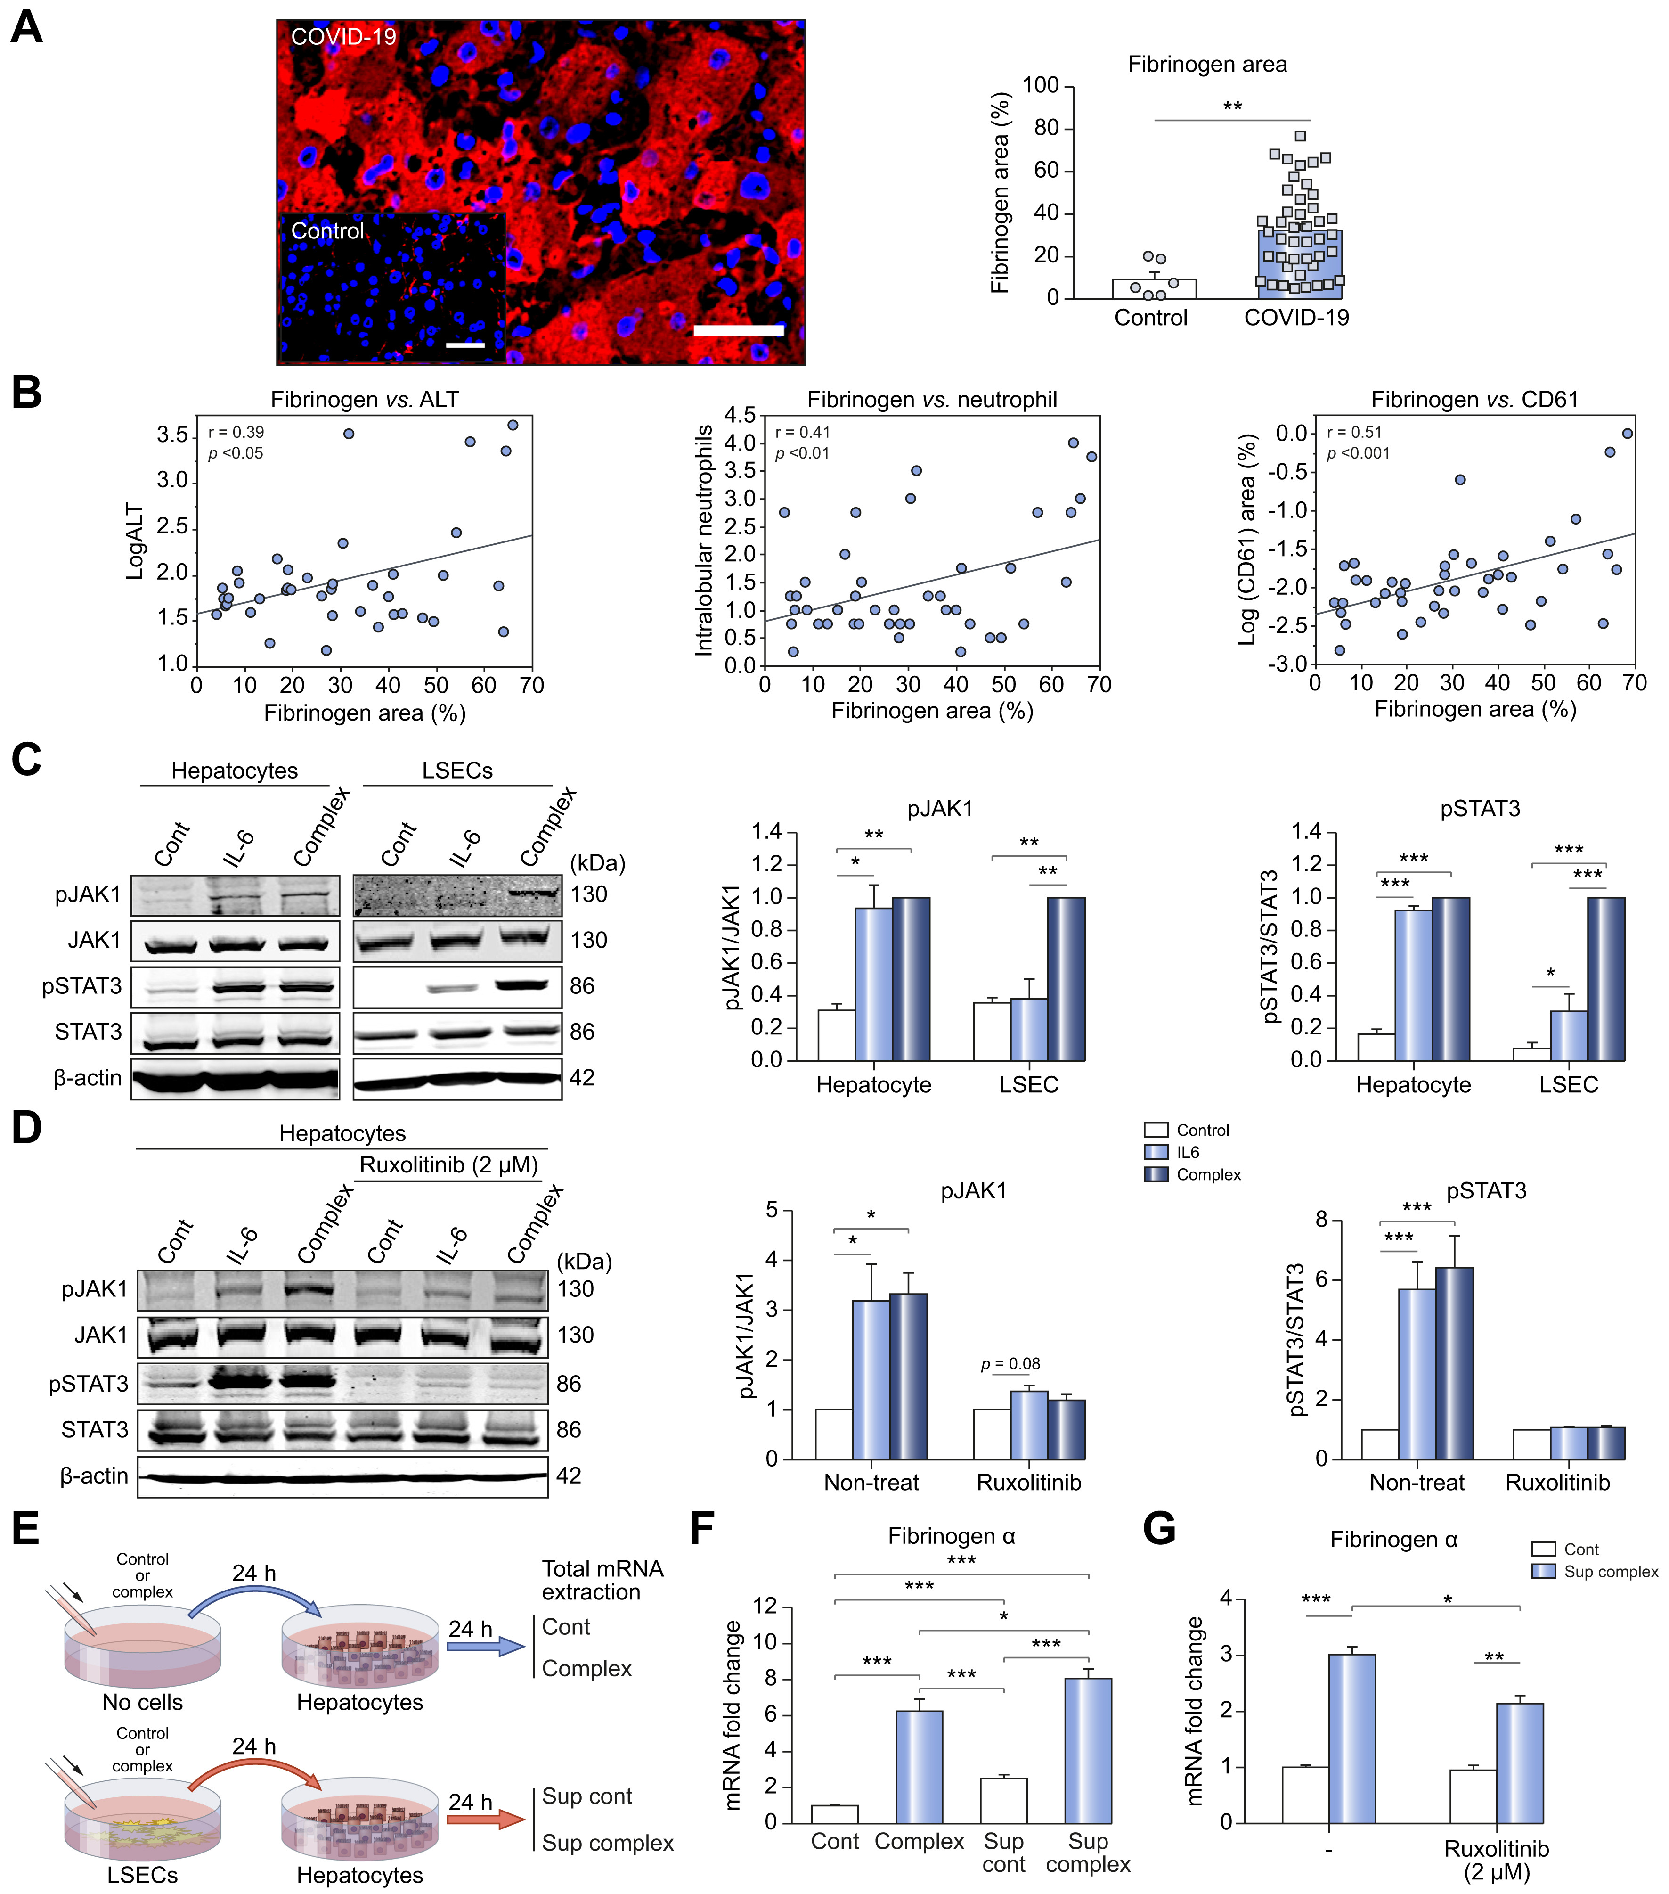
Fig. 6
Journal of Hepatology 2021 75647-658DOI: (10.1016/j.jhep.2021.04.050)
Copyright © 2021 European Association for the Study of the Liver Terms and Conditions
Notes:
Fibrinogen levels are increased in livers of patients with COVID-19 by IL-6 signaling amplified by LSEC-hepatocyte crosstalk.
(A) Representative immunolabeling of fibrinogen (Red) in livers from patients with COVID-19. Scale bar: 50 μm. Quantification of fibrinogen positive area (right panel) in patients with COVID-19 (n = 43) and controls (n = 6). (B) Correlation between fibrinogen area and ALT (n = 41), neutrophil infiltration (n = 43), and CD61 (n = 43) in livers of patients with COVID-19. (C) Western blot analyses in primary hepatocytes and primary LSECs treated with control, IL-6 alone (20 ng/ml) or IL-6/sIL-6R complex (20 ng/ml). Representative western blot (left) and its quantification (right panel). n = 3. Complex is set to 1 for each experiment and data presented as fold-change. (D) Western blot analyses in mouse primary hepatocytes treated with control, IL-6 alone (20 ng/ml) or IL-6/sIL-6R complex (20 ng/ml) in the presence or absence of ruxolitinib (2 μM) for 15 minutes. Ruxolitinib was added 20 minutes before treatment with IL-6 alone or complex. n = 3. The graphs show the fold-change (control is set to 1). (E) Experimental scheme for (F & G). (F) mRNA expression of fibrinogen. n = 9. The graphs show the fold-change (control is set to 1). (G) mRNA expression of fibrinogen in mouse primary hepatocytes treated with control medium or supernatant from LSECs treated with IL-6/sIL-6R complex for 24 hours in the presence or absence of ruxolitinib. n = 3. The graphs show the fold-change (control is set to 1). Data are the mean ± SEM of at least 3 experiments. Pearson’s correlation coefficients were calculated to examine the correlation among fibrinogen area, ALT, neutrophil infiltration and CD61 area. One-way ANOVA with Tukey’s test for multiple groups, or two-tailed unpaired t test for 2 groups was used. ∗p <0.05, ∗∗p <0.01, ∗∗∗p <0.001. ALT, alanine aminotransferase; IL-6, interleukin-6; LSECs, liver sinusoidal endothelial cells; sIL-6R, soluble IL-6 receptor.

