Slide 1




Il trattamento farmacologico della NASH
Salvatore Petta
Gastroenterologia, PROMISE,
Università di Palermo salvatore.petta@unipa.it

Slide 2

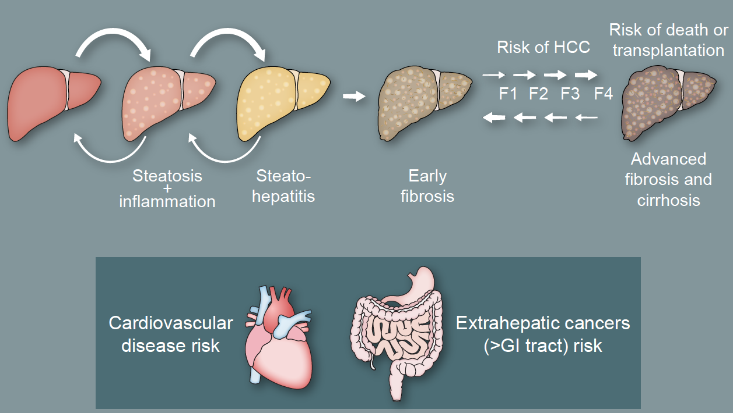
NAFLD Natural History

Slide 3


NAFLD Pharmacological Treatment
Hepatic
Disease
Extra-hepatic
Disease

Slide 4
NAFLD Pharmacological Treatment
The Present
Hepatic
Disease
Extra-hepatic
Disease

Slide 5
Vitamin E

Slide 6
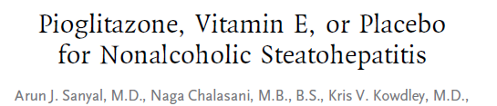
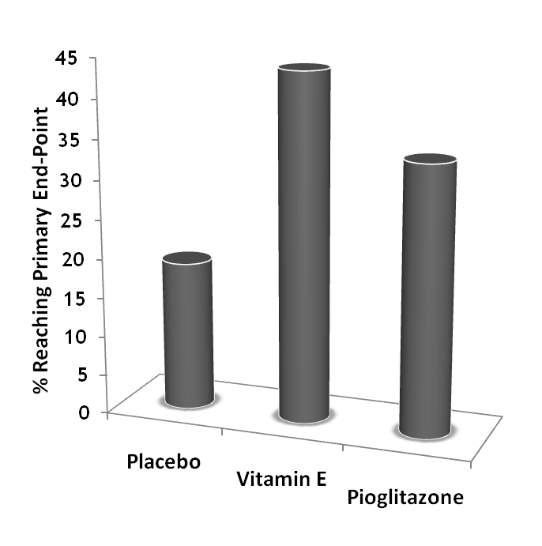
247 non-diabetic adults with NASH
  30mg Pioglitazone
  800IU Vitamin E
  Placebo
Liver biopsy at 96 Weeks
Both agents improved steatosis & inflammation scores
Only Vitamin E reduced ballooning
Neither agent reduced fibrosis
BUT resolution of NASH in 30-40% of patients treated
High-dose vitamin E linked to increased all-cause mortality, hemorrhagic stroke and prostate cancer
‘PIVENS’ Trial
p = 0.001
NNT 4.2
p = 0.04
NNT 6.9

Slide 7
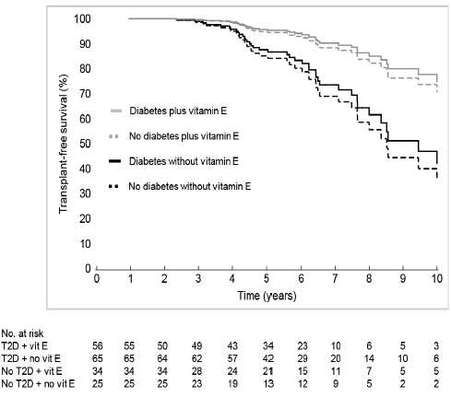
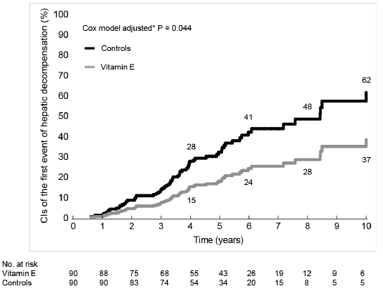
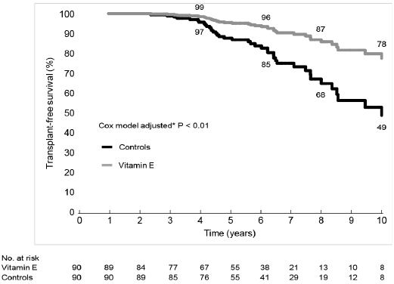
Vitamin E and NASH
90 NASH with bridging fibrosis or cirrhosis tooking 800 IU/day of vitamin E for ≥ 2 years and 90 propensity matched who did not take vitamin E (controls) were included. Median follow-up 5.6 yrs for both groups.
adj. HR: 0.30, 95% CI: 0.12-0.74, P<.01)
adj. sHR: 0.52, 95% CI: 0.28-0.96, P=.036)
Adjusted 10-year cumulative probability of HCC, vascular events and non-hepatic cancers were not different between vitamin E exposed and controls.
Vilar-Gomez et al, Hepatology 2018

Slide 8
AISF-SID-SIO NAFLD Guidelines 2021
In adult patients with NAFLD, what is the efficacy of pharmacological treatment on histologically-assessed liver damage and liver-related outcomes in comparison with no pharmacological intervention?
• In patients with NASH vitamin E may be used to improve NASH and fibrosis, even if risks and benefits should be discussed with each patient (B, 2)

Slide 9
Pioglitazone

Slide 10
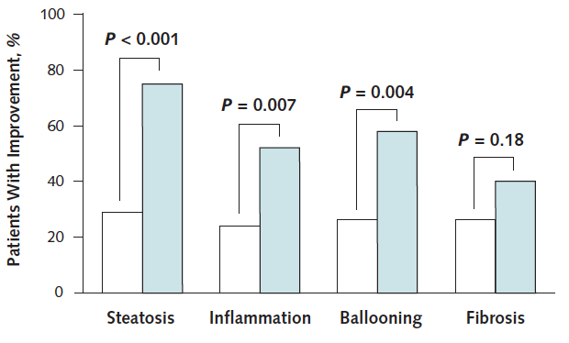

Pioglitazone and NASH
* In patients with paired biopsies (n = 82)
Cusi et al, Ann Intern Med 2016

Slide 11
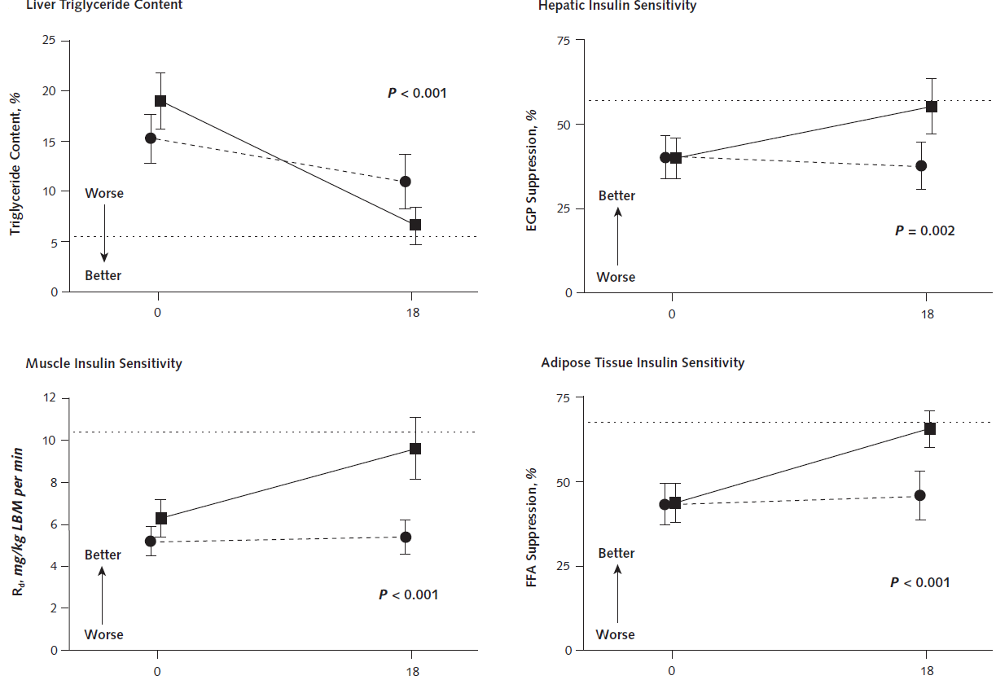
Pioglitazone and NASH
Cusi et al, Ann Intern Med 2016

Slide 12
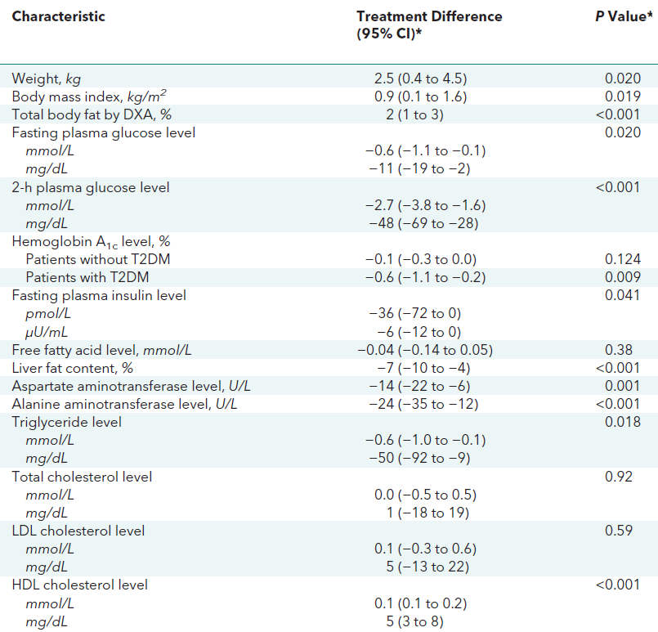
Pioglitazone and NASH
Cusi et al, Ann Intern Med 2016

Slide 13
AISF-SID-SIO NAFLD Guidelines 2021
In adult patients with NAFLD, what is the efficacy of pharmacological treatment on histologically-assessed liver damage and liver-related outcomes in comparison with no pharmacological intervention?
• In patients with NASH pioglitazone may be used to improve NASH and fibrosis, although the drug is off-label and the risk/benefit balance related to pioglitazone side-effects should be discussed with each patient (B, 2)

Slide 14
AISF-SID-SIO NAFLD Guidelines 2021
In adult patients with NAFLD and type 2 diabetes mellitus, what is the efficacy of glucose-lowering treatment on histologically-assessed liver damage and liver-related outcomes?
• In T2DM patients with NAFLD/NASH, pioglitazone is specifically recommended to treat liver disease (B, 2)
• In T2DM patients with NAFLD/NASH, metformin use is safe for the liver, but it is not specifically recommended to treat liver disease (B, 2)
• In T2DM patients with NAFLD/NASH, DPP-4 inhibitors are safe for the liver, but their use is not specifically recommended to treat liver disease (C, 2)
• In T2DM patients with NAFLD/NASH, GLP-1 receptor agonists are safe for the liver, but, despite preliminary evidence that may decrease liver damage, their use is not specifically approved to treat liver disease (B, 2)
• In T2DM patients with NAFLD/NASH, SGLT-2 inhibitors are safe for the liver, but their use is not specifically recommended to treat liver disease (C, 2)

Slide 15
NAFLD Pharmacological Treatment
The Future
Hepatic
Disease
Extra-hepatic
Disease

Slide 16
Drug Therapy and NASH:
What Targets?
Vuppalanchi et al, Gastroenterology 2021

Slide 17
NAFLD Pharmacological Treatment
The Future
Some Concerns
Who to Treat??

Slide 18
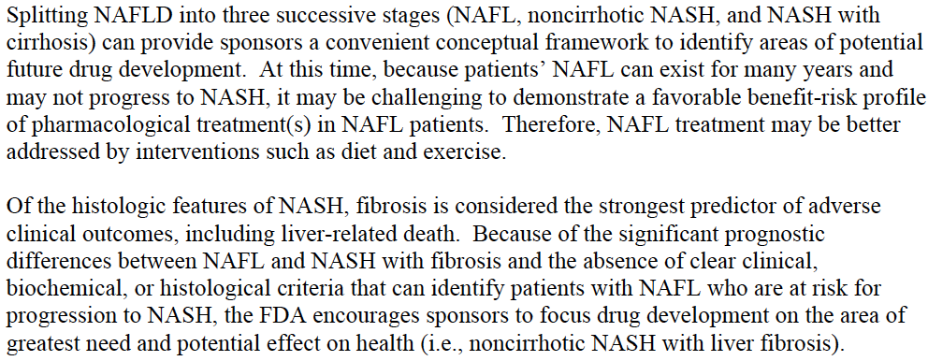
Who to Treat
FDA Recommendations
Noncirrhotic NASH

Slide 19
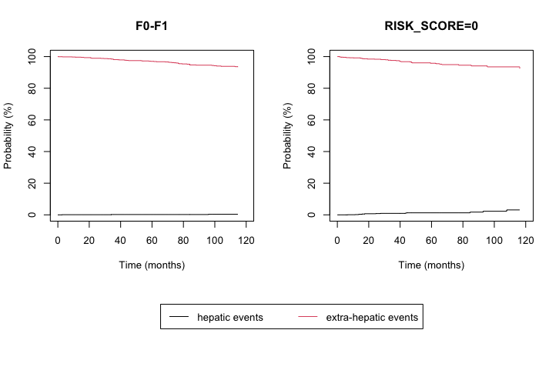

NAFLD Natural History: The role of Fibrosis
2,135 patients with biopsy-proven NAFLD → F0-F1=1136; F2=362; F3-F4=637
2,790 patients with clinical NAFLD → Low=1365; Intermediate=286; High risk of F3-F4 by LSM=1,139
F0-F1 fibrosis
Low risk of developing advanced fibrosis by LSM
Histological cohort
Validation cohort
 | 12 | 36 | 60 | 120
HE (%) | 0.1 | 0.2 | 0.2 | 0.4
EHE (%) | 0.4 | 1.9 | 3 | 6.6
 | 12 | 36 | 60 | 120
HE (%) | 0.2 | 0.9 | 1.3 | 3.1
EHE (%) | 0.8 | 2.4 | 4.2 | 7.6
Pennisi et al, APT 2022

Slide 20
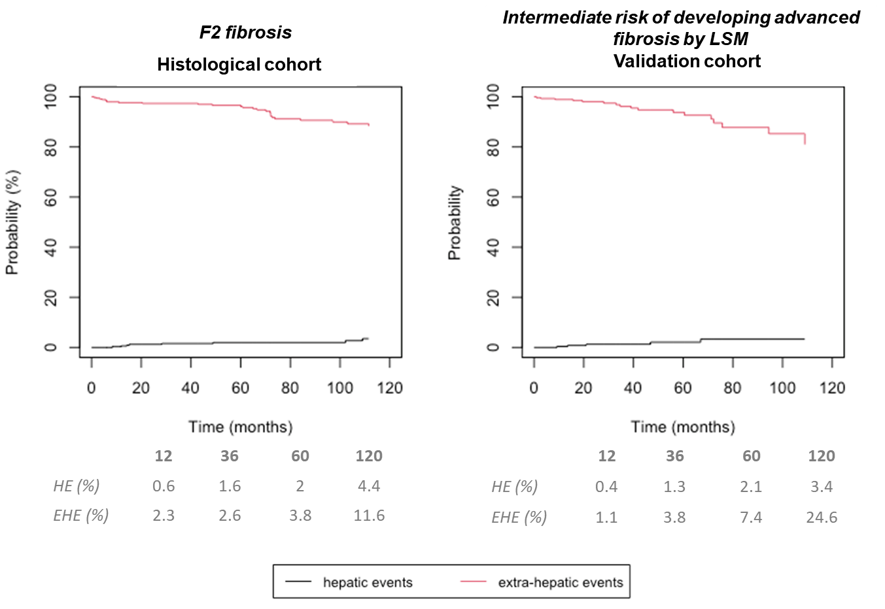
NAFLD Natural History: The role of Fibrosis
2,135 patients with biopsy-proven NAFLD → F0-F1=1136; F2=362; F3-F4=637
2,790 patients with clinical NAFLD → Low=1365; Intermediate=286; High risk of F3-F4 by LSM=1,139
Pennisi et al, APT 2022

Slide 21
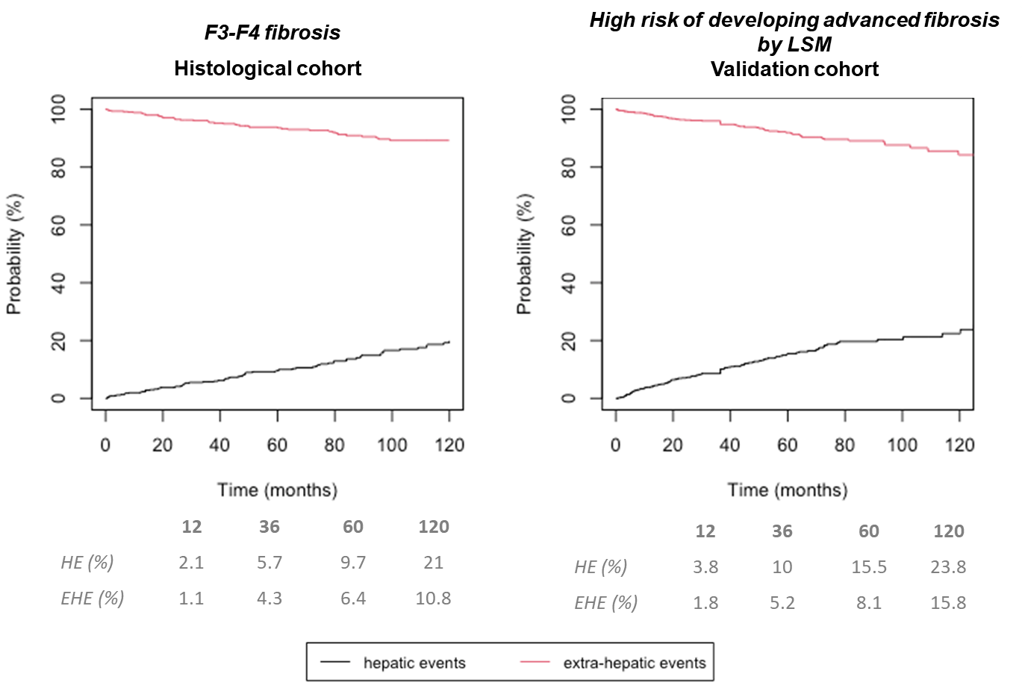
NAFLD Natural History: The role of Fibrosis
2,135 patients with biopsy-proven NAFLD → F0-F1=1136; F2=362; F3-F4=637
2,790 patients with clinical NAFLD → Low=1365; Intermediate=286; High risk of F3-F4 by LSM=1,139
Pennisi et al, APT 2022

Slide 22
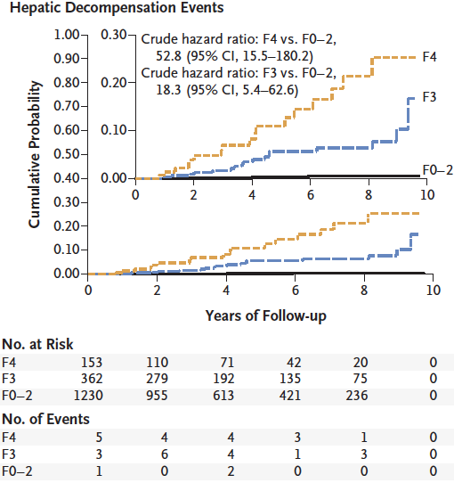
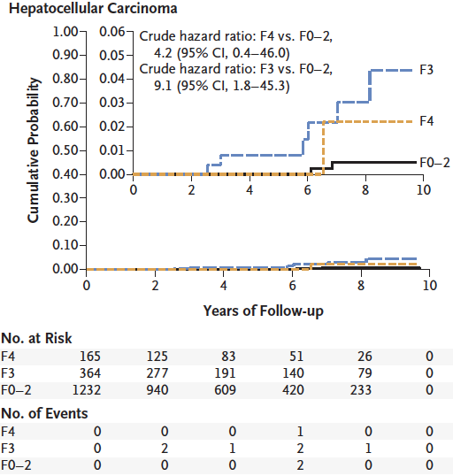
NAFLD Natural History: The role of Fibrosis
1,773 NAFLD patients by histology with a 4 year median follow-up
The incidence of liver-related complications per 100 person-years increased with fibrosis stage (F0 to F2 vs. F3 vs. F4) as follows: variceal hemorrhage (0.00 vs. 0.06 vs. 0.70), ascites (0.04 vs. 0.52 vs. 1.20), encephalopathy (0.02 vs. 0.75 vs. 2.39), and hepatocellular cancer (0.04 vs. 0.34 vs. 0.14).
Sanyal et al, NEJM 2021

Slide 23
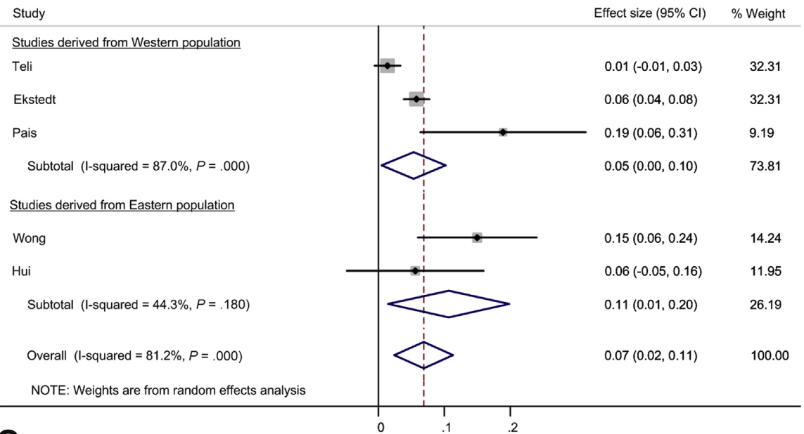
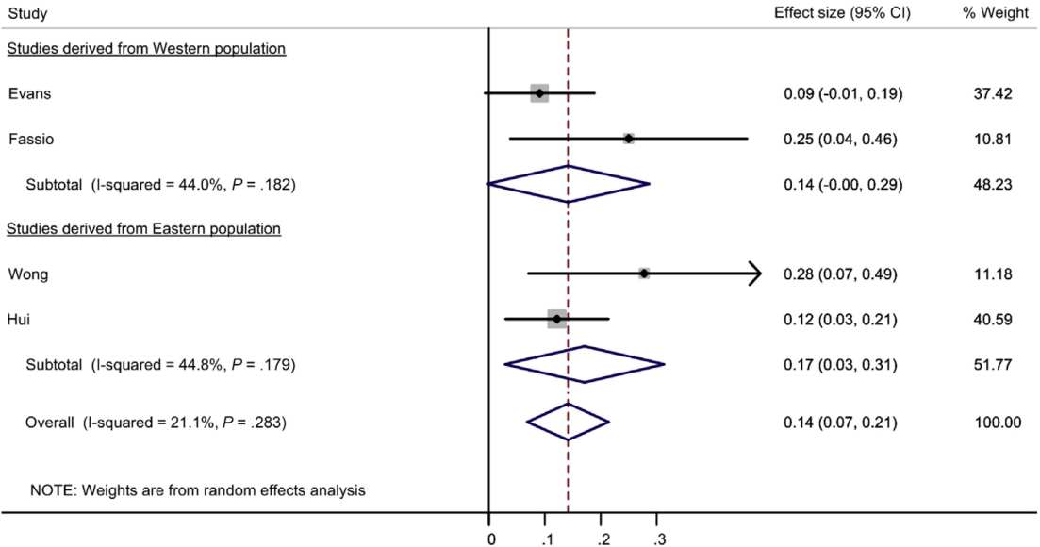
NAFLD Natural History: The role of NASH
150 NAFL
261 NASH
The annual fibrosis progression rate in patients with NAFL who had
stage 0 fibrosis at baseline was 0.07 stages
The annual fibrosis progression rate in patients with NAFL who had
stage 0 fibrosis at baseline was 0.14 stages
Singh et al, Clin Gastr Hep 2015

Slide 24
Is it right to treat (only) patients with Fibrotic NASH?

Slide 25
NAFLD Natural History: The role of NASH
1938 NAFLD patients by histology
aHR for developing LRE
F0-F1-NASH | 0.96 | (0.21 - 4.33) | 0.960
F2-F4-No NASH | 9.96 | (3.35 - 29.62) | <0.001
F2-F4-NASH | 10.14 | (3.51 - 29.25) | <0.001
Pennisi G et al, SUBMITTED

Slide 26
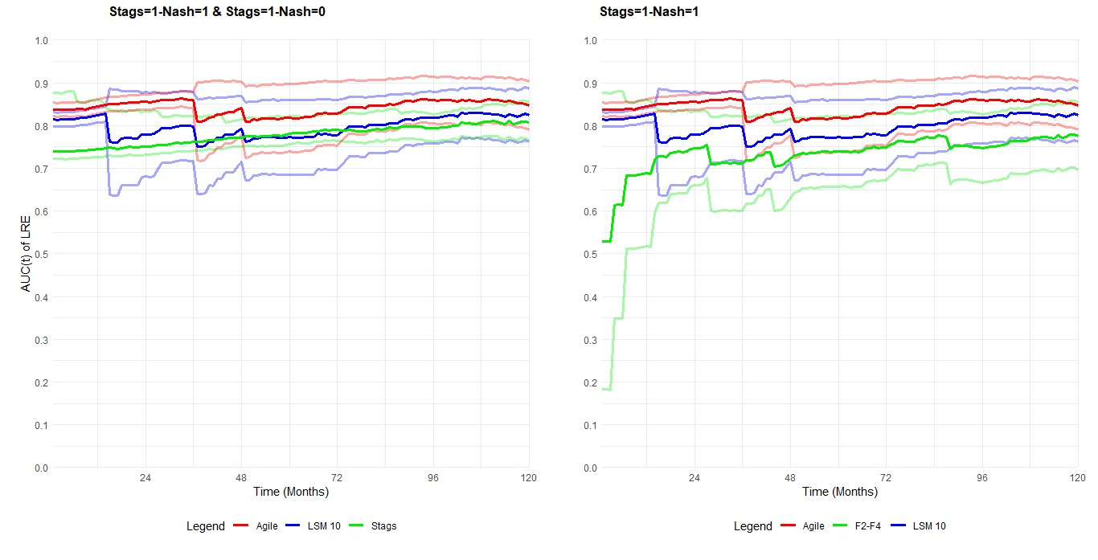
NAFLD Natural History: The role of NASH
1075 NAFLD patients by histology and with availability of LSM
LSM ≥10 KPa or AGILE 3+ >0.67 independently predicted the development of LRE and had similarly acceptable 5-year AUROC to fibrotic NASH and F2-F4 fibrosis
Pennisi G et al, SUBMITTED

Slide 27
NAFLD Pharmacological Treatment
The Future
Some Concerns
What Outcomes??

Slide 28
Rinella et al, JHEP 2019

Slide 29
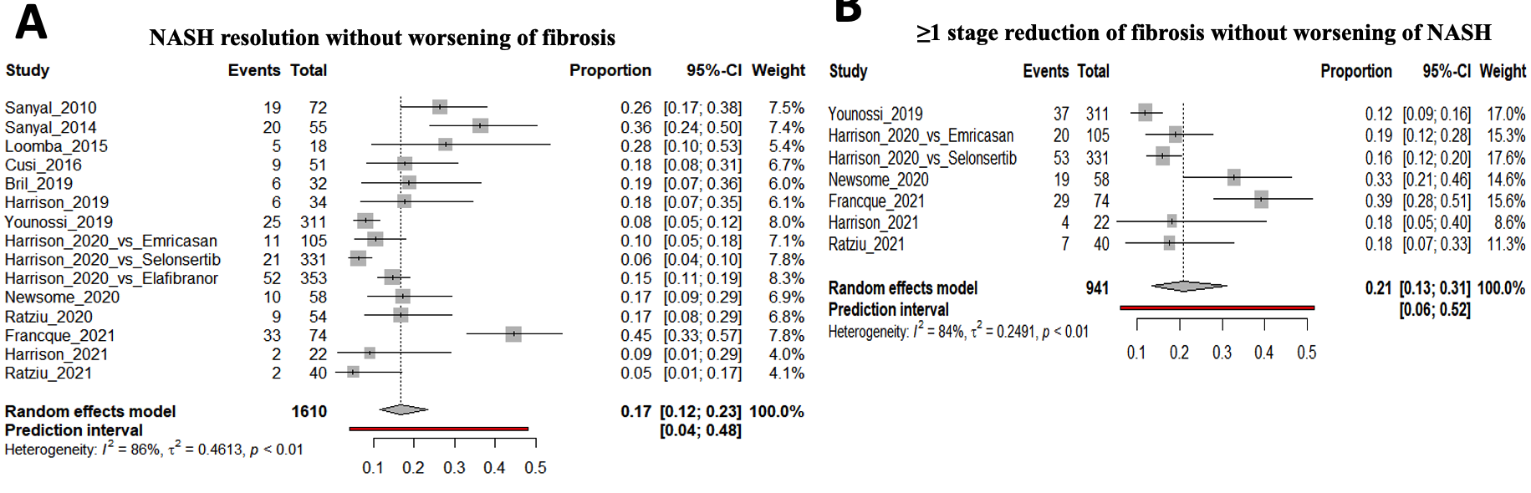
Clinical Endpoint in Phase 3 Trials: High Eterogeneity among Untreated Patients
Meta-regression analysis showed that phase 3 vs phase 2 trials, older age and higher baseline AST levels were risk factors for more rapid histological progression.
Pennisi et al, NMCD 2022

Slide 30
Drug Therapy and NASH:
What Targets?
Vuppalanchi et al, Gastroenterology 2021

Slide 31
FXR and NAFLD

Slide 32
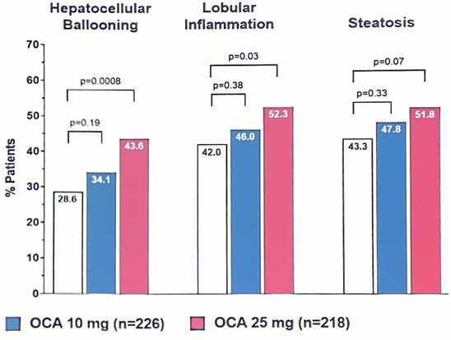
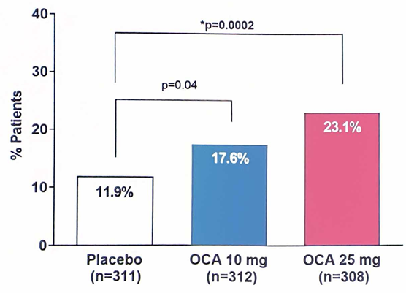
REGENERATE Study:
Obeticolic Acid in NASH Phase III Treatment Trial:
18 Months Interim Analysis
Fibrosis improvement ≥1 stage without NASH impairment
Improvement ≥1 Point
Higher Incidence of pruritus
Younossi et al, Lancet 2019

Slide 33
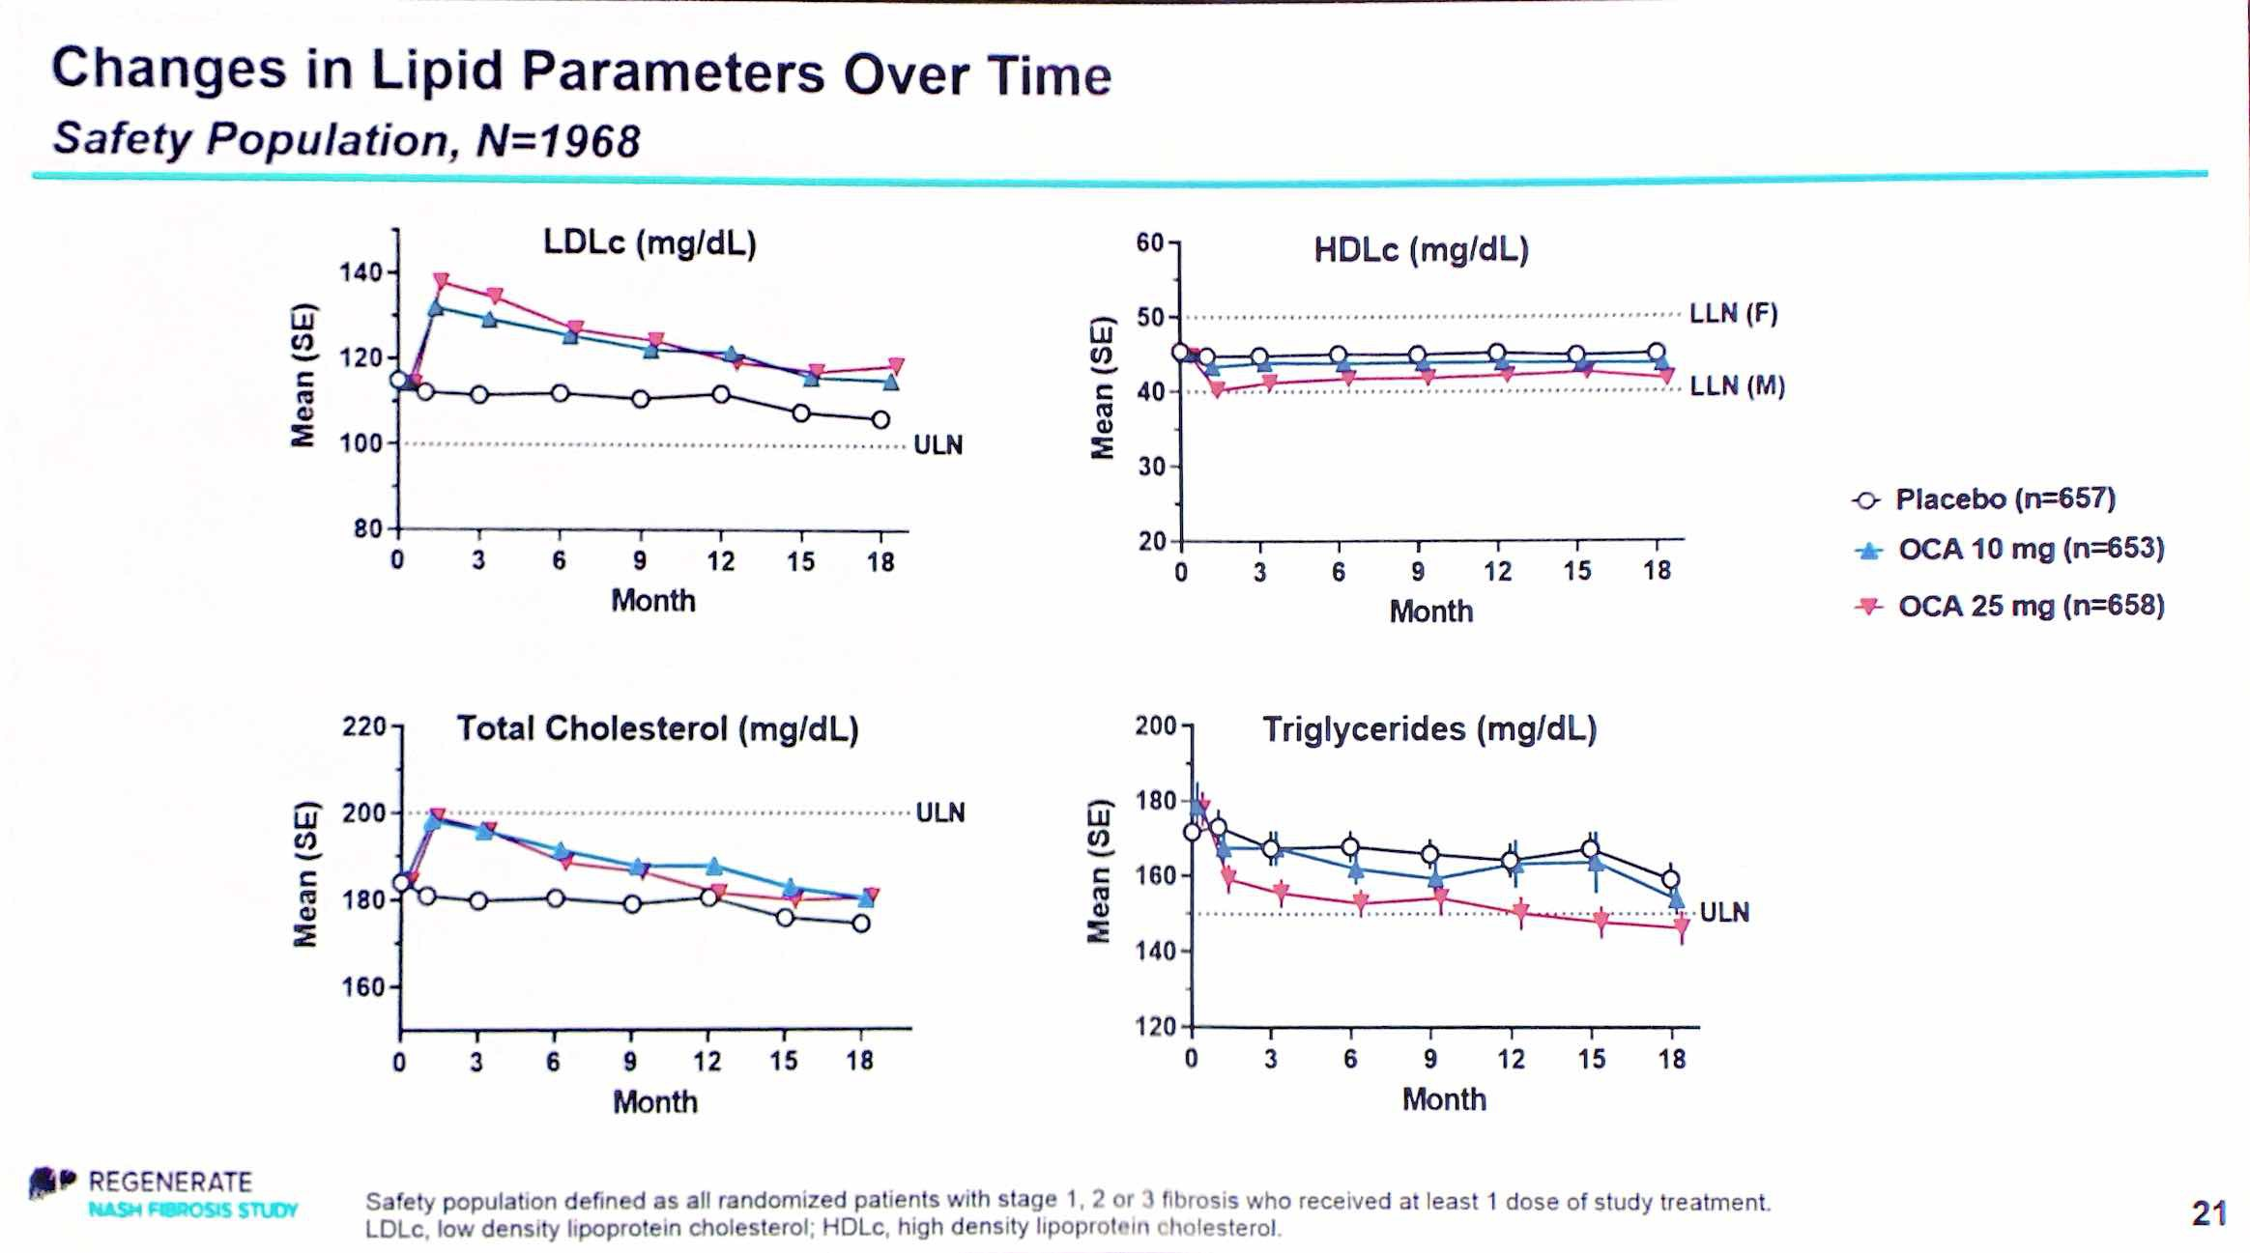
REGENERATE Study:
Obeticolic Acid in NASH Phase III Treatment Trial:
18 Months Interim Analysis
Younossi et al, Lancet 2019
Younossi et al, Lancet 2019

Slide 34
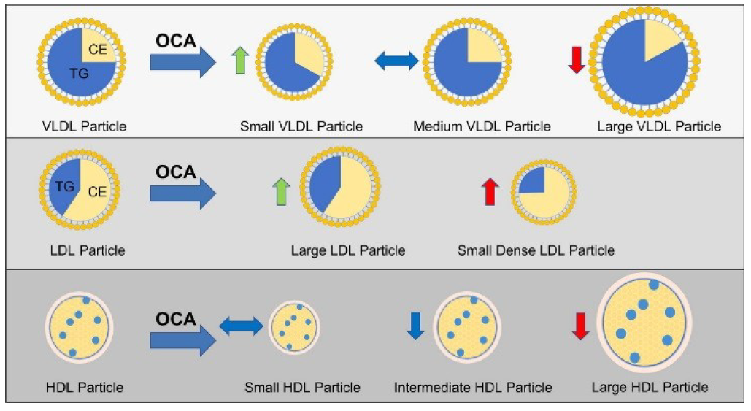
Obeticolic Acid and Lipoproteins in NASH
LDL Cholesterol Increase Sensitive to Statins
Siddiqui et al, JHEP 2020

Slide 35
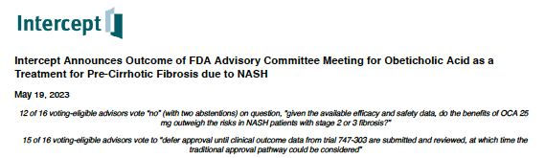
AISF-SID-SIO NAFLD Guidelines 2021
PICO 6 - In adult patients with NAFLD, what is the efficacy of pharmacological treatment on histologically-assessed liver damage and liver-related outcomes in comparison with no pharmacological intervention?
Recommendation
In patients with NASH pioglitazone may be used to improve NASH and fibrosis, although the drug is off-label and the risk/benefit balance related to pioglitazone side-effects should be discussed with each patient (B, 2)
In patients with NASH vitamin E may be used to improve NASH and fibrosis, even if risks and benefits should be discussed with each patient (B, 2)
In patients with NASH standard or high-dose ursodeoxycholic acid (UDCA) should not be used to treat NASH and fibrosis, because ineffective (B, 2)
In patients with NASH obeticholic acid may improve fibrosis without worsening of NASH, but its use is waiting for approval by regulatory agencies, based on additional safety and efficacy data (B, 2)

Slide 36
Drug Therapy and NASH:
What Targets?
Vuppalanchi et al, Gastroenterology 2021

Slide 37
GLP-1 Analogues and NASH

Slide 38
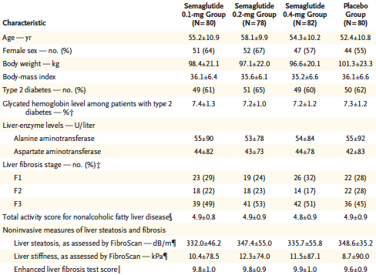
Semaglutide Phase 2b Study in NASH
NASH Patients with F1 to F3 Fibrosis (about 50% with F3)
60% with Diabetes
Newsome P et al, NEJM 2021
Notes:
1 patient du groupe placebo a été exclu en raison d’un traitement concommitant interdit.
3 patients dans chaque groupe n’ont pas eu de biopsie de contrôle.
L’objectif primaire de l’étude a été atteint 9/23 (39 %) (hypothèse 8/2, 38 %).

Slide 39
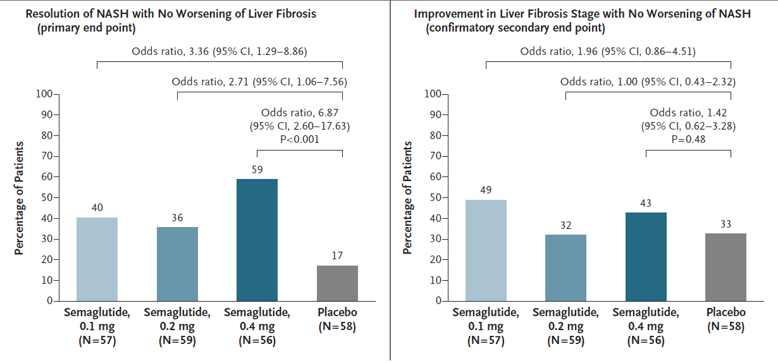
Semaglutide Phase 2b Study in NASH
NASH Patients with F2 to F3 Fibrosis
Similar results in the entire cohort including F1 patients, and when stratifying patients for diabetes
Newsome P et al, NEJM 2021
Notes:
1 patient du groupe placebo a été exclu en raison d’un traitement concommitant interdit.
3 patients dans chaque groupe n’ont pas eu de biopsie de contrôle.
L’objectif primaire de l’étude a été atteint 9/23 (39 %) (hypothèse 8/2, 38 %).

Slide 40
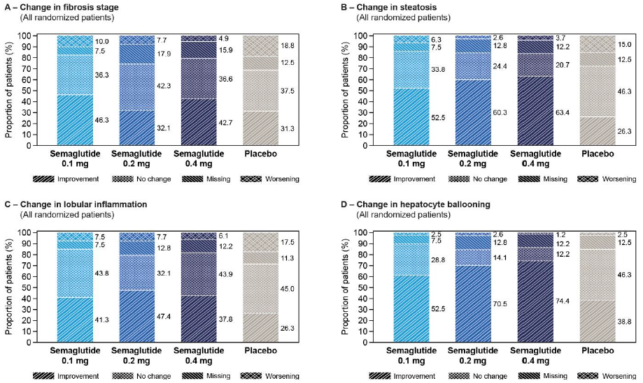
Semaglutide Phase 2b Study in NASH
NASH Patients with F1 to F3 Fibrosis (about 50% with F3)
60% with Diabetes
Newsome P et al, NEJM 2021
Notes:
1 patient du groupe placebo a été exclu en raison d’un traitement concommitant interdit.
3 patients dans chaque groupe n’ont pas eu de biopsie de contrôle.
L’objectif primaire de l’étude a été atteint 9/23 (39 %) (hypothèse 8/2, 38 %).

Slide 41
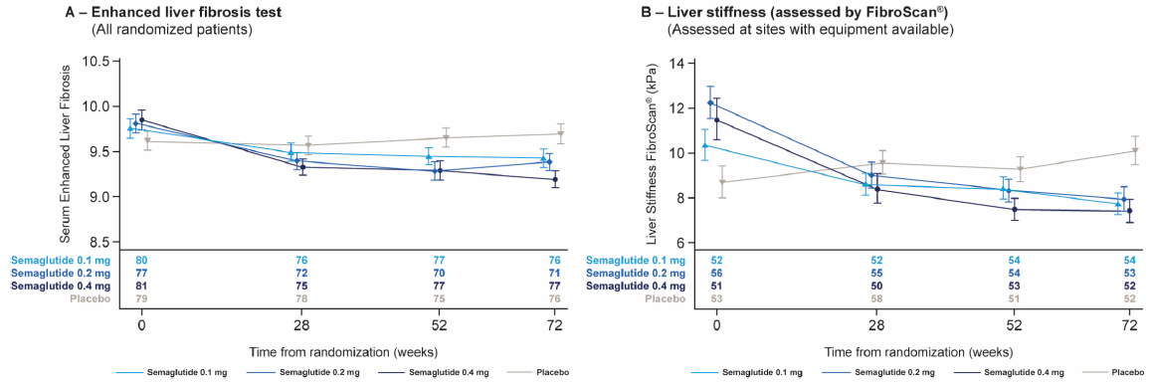
Semaglutide Phase 2b Study in NASH
NASH Patients with F1 to F3 Fibrosis (about 50% with F3)
60% with Diabetes
Newsome P et al, NEJM 2021
Notes:
1 patient du groupe placebo a été exclu en raison d’un traitement concommitant interdit.
3 patients dans chaque groupe n’ont pas eu de biopsie de contrôle.
L’objectif primaire de l’étude a été atteint 9/23 (39 %) (hypothèse 8/2, 38 %).

Slide 42
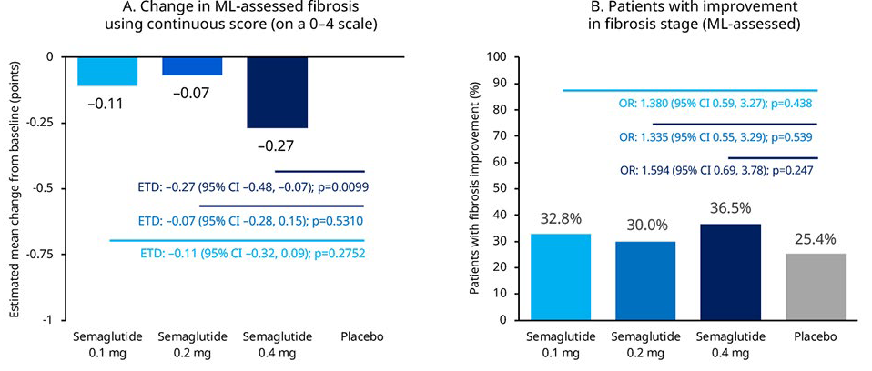
Semaglutide Phase 2b Study in NASH
250 NASH Patients with available digitalized reading of liver biopsies
Artificial intelligence (AI)-powered digital pathology and changes in fibrosis
Harrison et et al, AASLD 2021
Notes:
1 patient du groupe placebo a été exclu en raison d’un traitement concommitant interdit.
3 patients dans chaque groupe n’ont pas eu de biopsie de contrôle.
L’objectif primaire de l’étude a été atteint 9/23 (39 %) (hypothèse 8/2, 38 %).

Slide 43
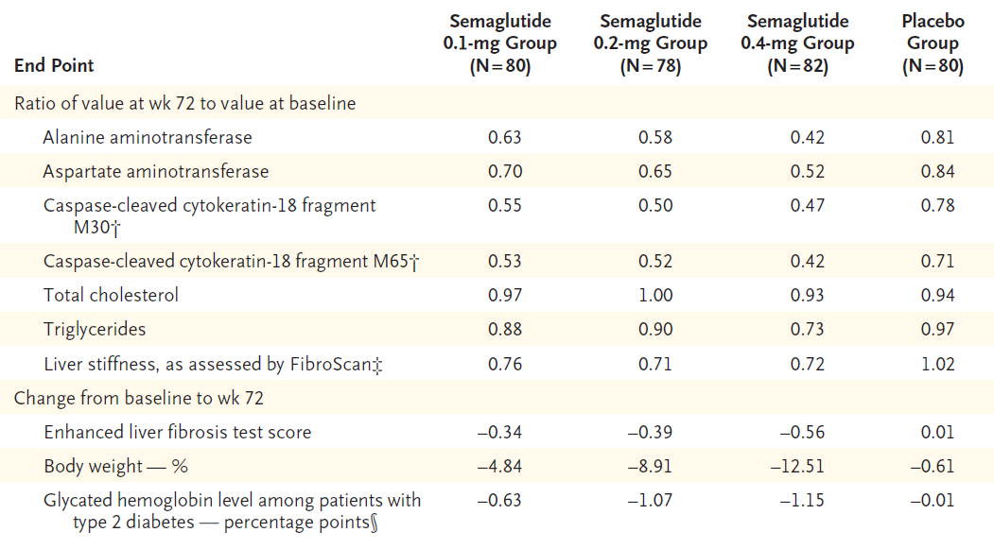
Semaglutide Phase 2b Study in NASH
NASH Patients with F1 to F3 Fibrosis (about 50% with F3)
60% with Diabetes
Newsome P et al, NEJM 2021
Notes:
1 patient du groupe placebo a été exclu en raison d’un traitement concommitant interdit.
3 patients dans chaque groupe n’ont pas eu de biopsie de contrôle.
L’objectif primaire de l’étude a été atteint 9/23 (39 %) (hypothèse 8/2, 38 %).

Slide 44
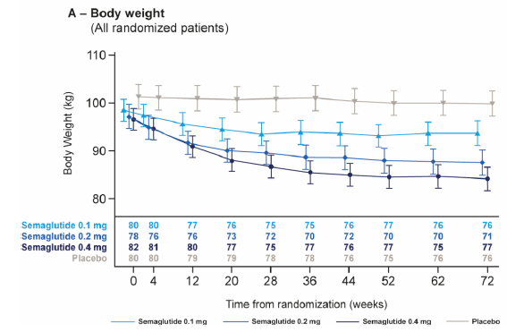
Semaglutide Phase 2b Study in NASH
NASH Patients with F1 to F3 Fibrosis (about 50% with F3)
60% with Diabetes
Newsome P et al, NEJM 2021
Notes:
1 patient du groupe placebo a été exclu en raison d’un traitement concommitant interdit.
3 patients dans chaque groupe n’ont pas eu de biopsie de contrôle.
L’objectif primaire de l’étude a été atteint 9/23 (39 %) (hypothèse 8/2, 38 %).

Slide 45
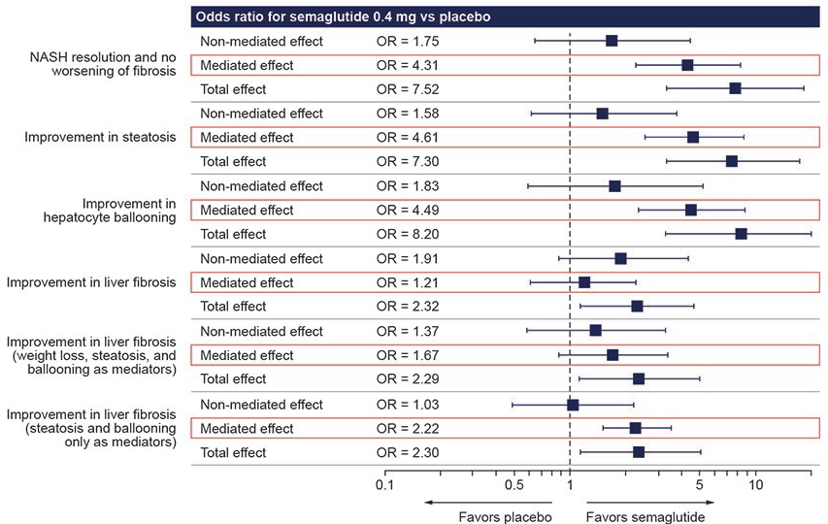
Semaglutide Phase 2b Study in NASH
249 NASH Patients
Mediated (weight-loss) and non-mediate (weight-loss independent treatment effect on histological improvement of semaglutide vs placebo)
Weight loss directly mediated a major part of NASH resolution without worsening of fibrosis (72.4% of total effect), as well as improvement in steatosis (76.8%) and hepatocyte ballooning (71.3%). Conversely, improvement in fibrosis was not directly mediated by weight loss (23.1% of total effect), as steatosis and ballooning accounted for 95.9% of the total effect
Ratziu V et al, AASLD 2021
Notes:
1 patient du groupe placebo a été exclu en raison d’un traitement concommitant interdit.
3 patients dans chaque groupe n’ont pas eu de biopsie de contrôle.
L’objectif primaire de l’étude a été atteint 9/23 (39 %) (hypothèse 8/2, 38 %).

Slide 46
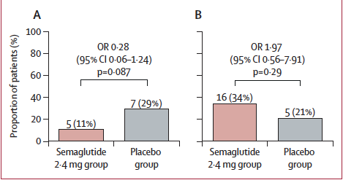
Semaglutide Phase 2 Study in NASH-Cirrhosis
71 Patients with histological NASH-related compensated cirrhosis
47 on semaglutide 2.4 week, and 21 on placebo
48 week treatment
Patients on semaglutide had significantly improvement respect to placebo on steatosis by MRI-PDFF, ALT level, and PRO-C3, not in MRE stiffness
Loomba R et al, LGH 2023
Notes:
1 patient du groupe placebo a été exclu en raison d’un traitement concommitant interdit.
3 patients dans chaque groupe n’ont pas eu de biopsie de contrôle.
L’objectif primaire de l’étude a été atteint 9/23 (39 %) (hypothèse 8/2, 38 %).

Slide 47
AISF-SID-SIO NAFLD Guidelines 2021
PICO 7 - In adult patients with NAFLD and type 2 diabetes mellitus, what is the efficacy of glucose-lowering treatment on histologically-assessed liver damage and liver-related outcomes?
Recommendation
In T2DM patients with NAFLD/NASH, pioglitazone is specifically recommended to treat liver disease (B, 2)
In T2DM patients with NAFLD/NASH, metformin use is safe for the liver, but it is not specifically recommended to treat liver disease (B, 2)
In T2DM patients with NAFLD/NASH, DPP-4 inhibitors are safe for the liver, but their use is not specifically recommended to treat liver disease (C, 2)
In T2DM patients with NAFLD/NASH, GLP-1 receptor agonists are safe for the liver, but, despite preliminary evidence that may decrease liver damage, their use is not specifically approved to treat liver disease (B, 2)
In T2DM patients with NAFLD/NASH, SGLT-2 inhibitors are safe for the liver, but their use is not specifically recommended to treat liver disease (C, 2)

Slide 48
Drug Therapy and NASH:
What Targets?
Vuppalanchi et al, Gastroenterology 2021

Slide 49
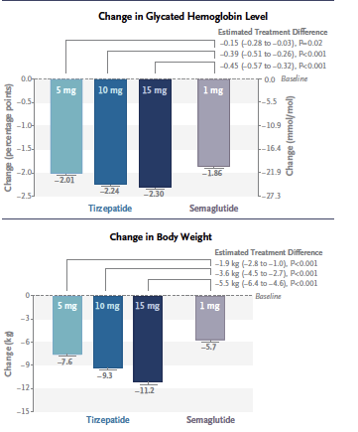

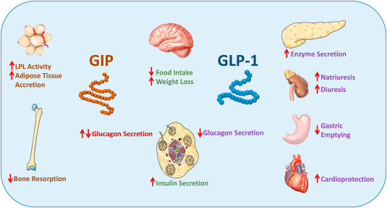
Dual GIP-GLP-1 Agonist
Franque et al, NEJM 2021

Slide 50
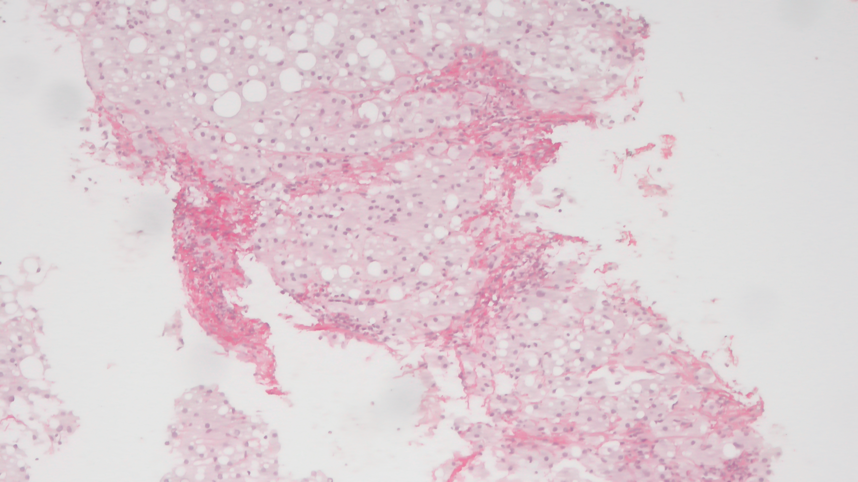
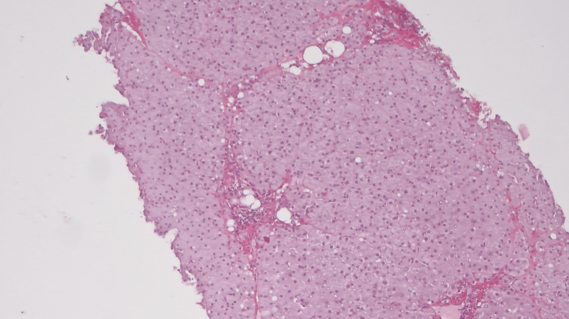
Glp-1 or GIP-GLP-1 Agonist: A Clinical case
57 yrs Female, 1 year Tretament
Steatosis 80%
Lobular Inflammation 2/3 Ballooning 2/2
Fibrosis 3/4
H 165 cm; Weight 81 Kg
Steatosis 2%
Lobular Inflammation 1/3 Ballooning 0/2
Fibrosis 3/4
H 165 cm; Weight 61 Kg

Slide 51
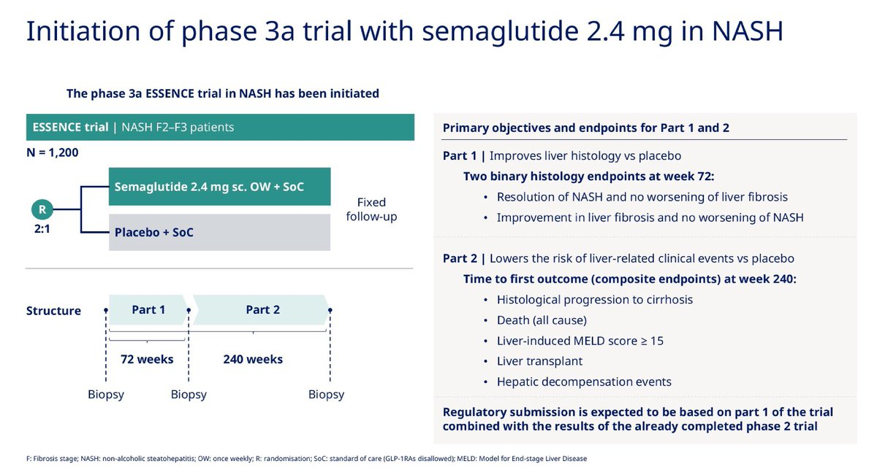
Semaglutide Phase 3 Study in NASH:
The ESSENCE Trial
Notes:
1 patient du groupe placebo a été exclu en raison d’un traitement concommitant interdit.
3 patients dans chaque groupe n’ont pas eu de biopsie de contrôle.
L’objectif primaire de l’étude a été atteint 9/23 (39 %) (hypothèse 8/2, 38 %).

Slide 52
Drug Therapy and NASH:
What Targets?
Vuppalanchi et al, Gastroenterology 2021

Slide 53

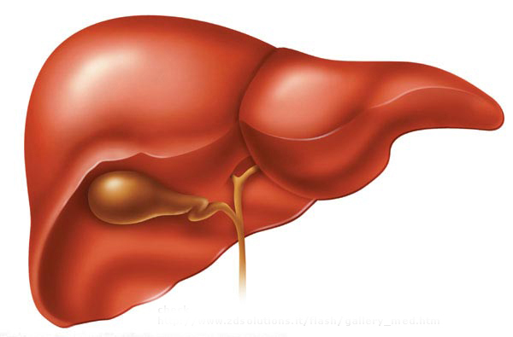
Lanifibranor: A new generation pan-PPAR agonist
Improves insulin sensitivity
Normalises lipid and adiponectin levels
IVA337
PPARα, δ, γ agonist
Reverses established fibrosis
Inhibits
steatosis
Blocks inflammation
Wettstein et al., EASL 2016, PS068

Slide 54
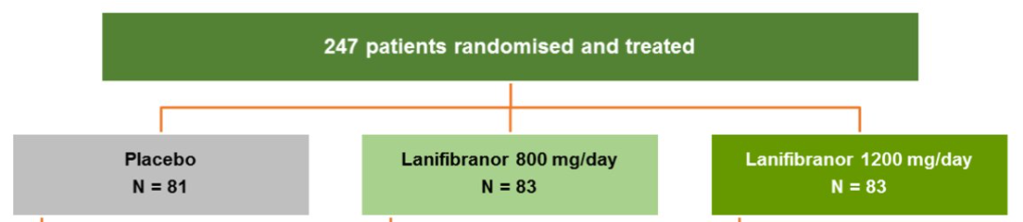
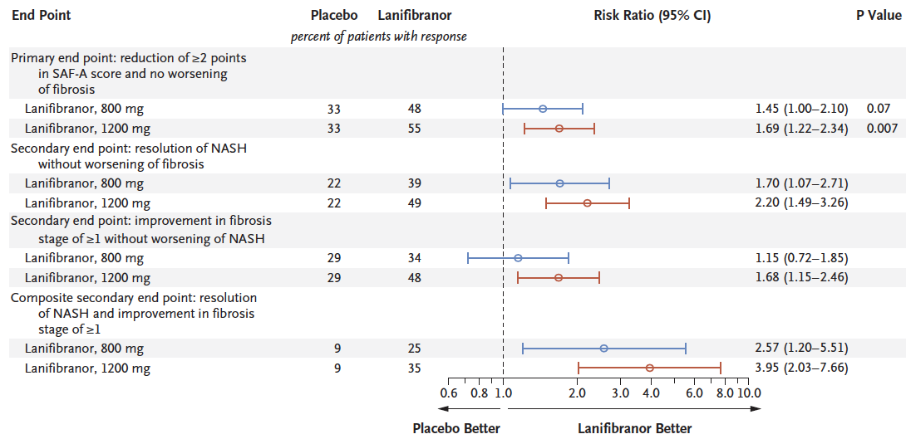
Lanifibranor in NASH
24 week treatment
Franque et al, NEJM 2021

Slide 55
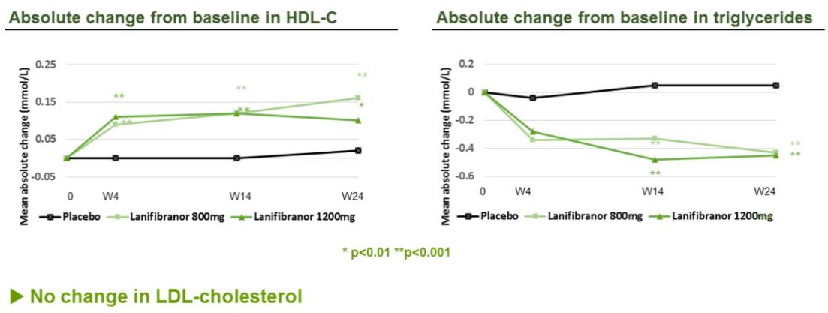
Lanifibranor in NASH
24 week treatment
No change in LDL.cholesterol
Decrease of insulin, fasting glucose and glycated haemoglobin (HB1AC) in patients with type 2 diabetes
Small weight gain and peripheral edema
Franque et al, NEJM 2021

Slide 56
Drug Therapy and NASH:
What Targets?
THRbeta
agonist
Rotman et al, GUT 2016

Slide 57
Thyroid Normone and NAFLD/NASH
MGL-3196 and VK-2809 under investigation

Slide 58
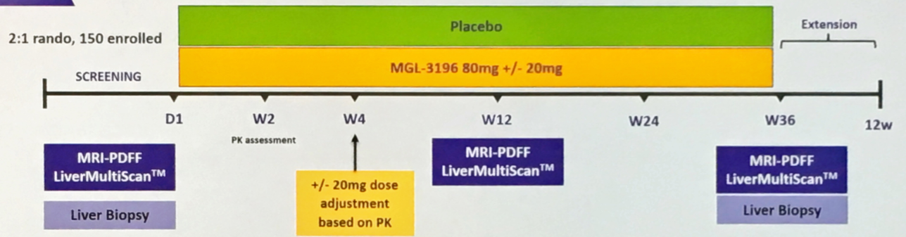
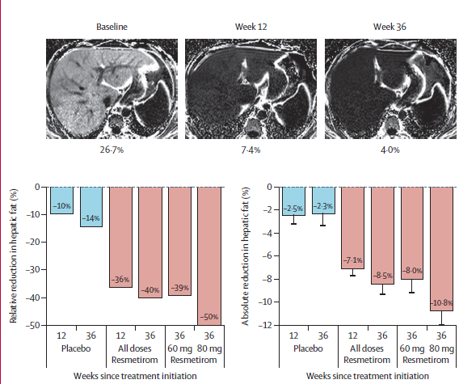

Resmetirom in NASH
Harrison et al, NEJM 2019

Slide 59
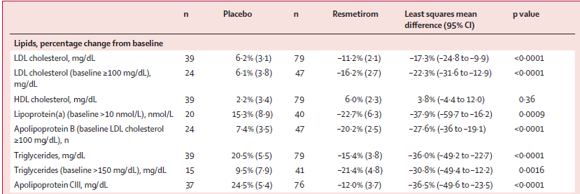
Resmetirom in NASH
Harrison et al, NEJM 2019

Slide 60
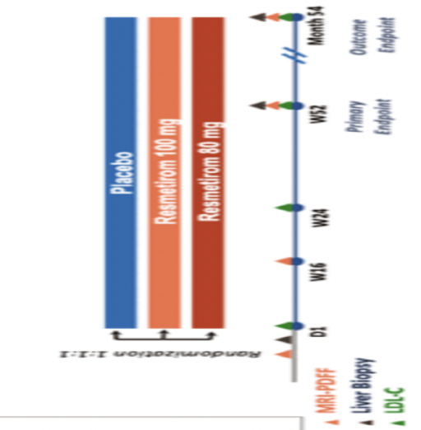
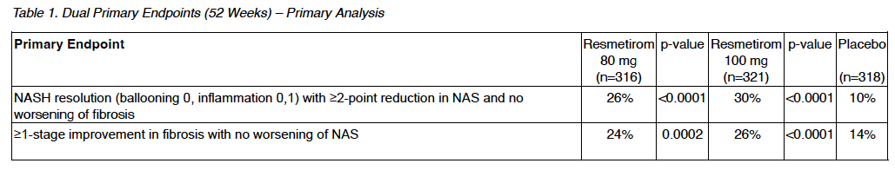
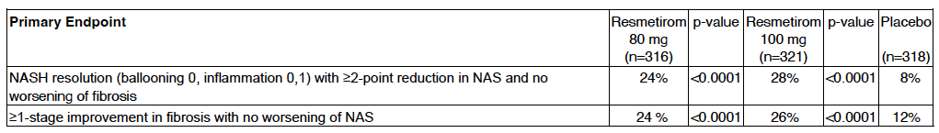
Resmetirom in NASH: MAESTRO Phase 3 Trial
MADRIGAL Press Release Jan 2023

Slide 61
NAFLD Pharmacologica Treatment
Hepatic
Disease
Extra-hepatic
Disease

Slide 62
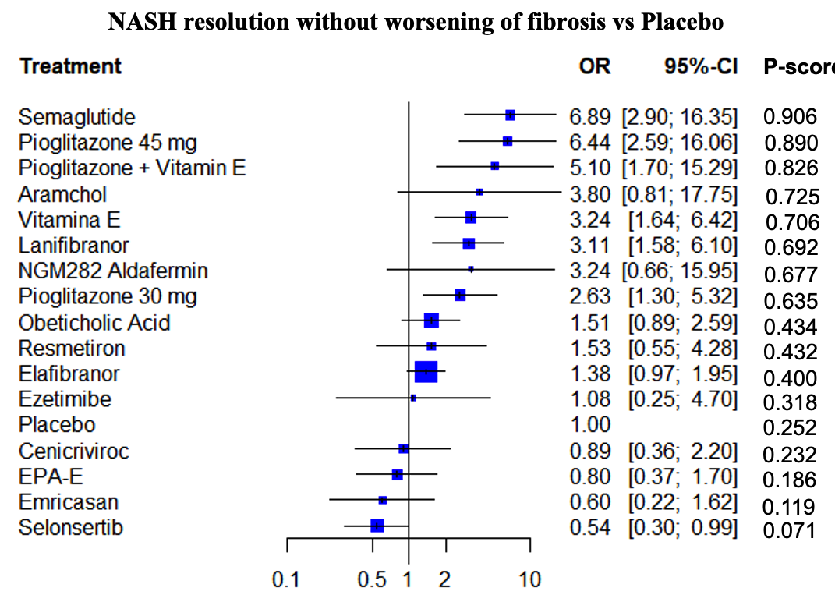
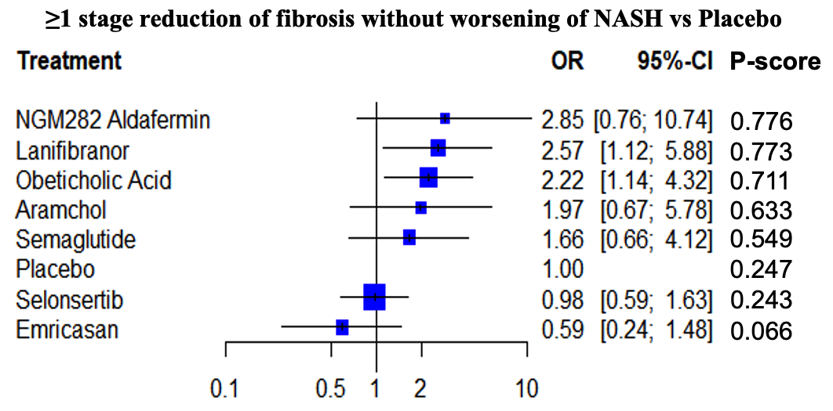
NAFLD Pharmacologica Treatment
A Network Meta-analysis
Look at Trials for
Combination Theraphy
Pennisi et al, NMCD 2022

Slide 63

Drug Theraphy: Unsolved Issues
Treat only Fibrotic NASH??
Placebo Response
Single or Combo Theraphy?
How to select Patients?
How to define treatment response?
If nonresponder add-on or switch-to?
Are there Stopping Rules?
Discussion is open……

Slide 64
RESIST-NASH
Centers
12 Gastroenterological
7 Internal Medicine
7 Infectious Disease
8 Diabetology
3
15
2
2
3
3
3
9 FibroScan Devices
2
2

Slide 65

The RESIST-NASH Pathway

